Slide 1

.NET Core: Developing Cross-Platform Web Apps with ASP.NET Core – WorkshopPLUS
< Engineer Name >
Premier Field Engineer
v3.1

Slide 2
For more information, see Use of Microsoft Copyrighted Content at
http://www.microsoft.com/en-us/legal/intellectualproperty/Permissions/default.aspx
Azure, Internet Explorer, Microsoft, SQL Server, Visual Studio, Windows, and Windows Server are either registered trademarks or trademarks of Microsoft Corporation in the United States and/or other countries. Other Microsoft products mentioned herein may be either registered trademarks or trademarks of Microsoft Corporation in the United States and/or other countries. All other trademarks are property of their respective owners.

Slide 3
How to View This Presentation
To switch to Notes Page view:
On the ribbon, click the View tab, and then click Notes Page
To navigate through notes, use the Page Up and Page Down keys
Zoom in or zoom out, if required
In the Notes Page view, you can:
Read any supporting text
Terminology List—a list of terms used in this course is provided in the Notes section.
Add notes to your copy of the presentation, if required
Take the presentation files home with you
Notes:
Terminology List:

Slide 4
Module 9: Security
Module Overview
Notes:
This module includes the following sections:
Section 1: Security Fundamentals
Section 2: ASP.NET Identity
Section 3: Security Threats and Defenses
Section 4: Trending Web Attacks

Slide 5
Module 9: Security
Section 1: Security Fundamentals
Lesson: Overview

Slide 6
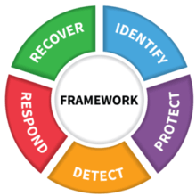
What Is Security?
Security, in information technology (IT), is the defense of digital information and IT assets against internal and external, malicious and accidental threats. This defense includes detection, prevention and response to threats through the use of security policies, software tools and IT services.
The National Institute of Standards and Technology (NIST) suggests a framework with five pillars or functions of security:
Identify
Protect
Detect
Respond
Recover
Notes:
https://searchsecurity.techtarget.com/definition/security
https://www.nist.gov/cyberframework/online-learning/five-functions
Identify
The Identify Function assists in developing an organizational understanding to managing cybersecurity risk to systems, people, assets, data, and capabilities. Understanding the business context, the resources that support critical functions, and the related cybersecurity risks enables an organization to focus and prioritize its efforts, consistent with its risk management strategy and business needs.
Protect
The Protect Function outlines appropriate safeguards to ensure delivery of critical infrastructure services. The Protect Function supports the ability to limit or contain the impact of a potential cybersecurity event.
Detect
The Detect Function defines the appropriate activities to identify the occurrence of a cybersecurity event. The Detect Function enables timely discovery of cybersecurity events.
Respond
The Respond Function includes appropriate activities to take action regarding a detected cybersecurity incident. The Respond Function supports the ability to contain the impact of a potential cybersecurity incident.
Recover
The Recover Function identifies appropriate activities to maintain plans for resilience and to restore any capabilities or services that were impaired due to a cybersecurity incident. The Recover Function supports timely recovery to normal operations to reduce the impact from a cybersecurity incident.

Slide 7
What Is Security? How to Think About It?
Prevention
Prevent the system from reaching compromised state
For example, Secure Development Lifecycle
Detection and Recovery
Detect that the system has been compromised and recover it to secure state
For example, Intrusion Detection Systems (IDS)
Resilience
Ensure minimum functionality in the compromised state
For example, redundancy or diversity in physical infrastructure or technology
Deterrence
Deter the malicious users/mechanisms from malicious acts
For example, Law enforcement, legislations, international collaboration
Notes:
These are the four dimensions of security. All security defenses fall into one of these four categories:
Prevention:
Secure Development Lifecycle: Using Anti-Cross Site Scripting (Anti-XSS) library in the code to prevent cross-site scripting (XSS) attacks from happening.
Detection and Recovery:
It usually falls outside the scope of software development in production environments. Antiviruses and Intrusion Detection Systems (IDS) are good examples of this type of defense.
Resilience:
It ensures that if an application or system is compromised, we still offer minimum set of functionality/services. For example, if a data center’s network capability is brought down by distributed denial of service attack, having a less-capable yet redundant/alternative data center at some other network location will be useful to offer minimum set of functionality to consumers despite service availability being partially compromised.
Deterrence:
It refers to law enforcement against malicious acts. For example, Sarah Palin’s email hack and its legal proceedings in court should serve as deterrent for any individual who wants to commit a malicious act of getting unauthorized access to someone’s personal email account.

Slide 8
Security Principles
Do not trust anything (including user input)
Know the weakest link
Multiple layers of security
Least privilege
Secure fallback when things go wrong
Universally check access permissions
Minimize shared information
Do not depend on secrecy
Keep it simple (KISS)
Notes:
These are general security principles that are applicable to everything that we do in computing. This set of principles should serve as a reference point to anyone concerned about application/system/network/infrastructure security.

Slide 9
Identity
How do we represent a user in our application?
Typically: A collection of key : value pairs that describe a specific user
A pair is referred to as a claim
The collection of claims makes up an Identity
Represented in code as a model we can create, store, and manipulate
Can be unique to your app, or shared across apps (Single Sign On)
{
“userID”: “83b6734e”,
“username”: “SuzyQ”,
“Name”: “Suzy”,
“givenName”: “Q”,
“premiumMember”: true
}
👧
{
“userID”: “ba35b637”,
“username”: “JohnDoe”,
“Name”: “John”,
“givenName”: “Doe”,
“premiumMember”: false
}
👦
Notes:
Identity is the base unit that we can deal with in terms of application use
An identity can be as simple as a unique username in our application, or as complex as a large collection of claims and

Slide 10
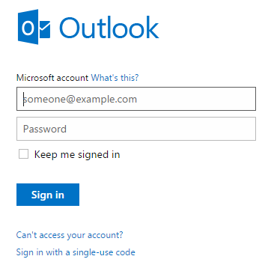
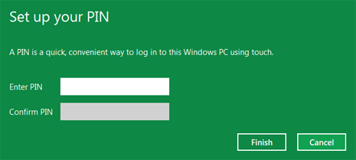
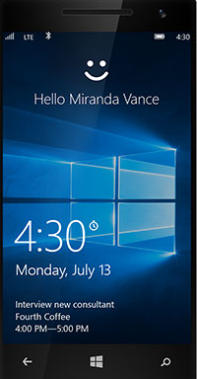
Authentication
Verifying the users are who they say they are
Notes:
The diagrams above give examples of various ways through which a user can be authenticated.
Windows Hello: Windows Hello introduces system support for biometric authentication – using your face, iris, or fingerprint to unlock your devices.
Windows Live Sign-In: It uses standard email address and password to authenticate users.
Windows Pin: User is authenticated through a 4-digit pin code. It is an alternative to typing in long and complex password each time.
You may also want to briefly discuss about multi-factor authentication. For more information, see: http://en.wikipedia.org/wiki/Authentication#Authentication_factors_and_identity

Slide 11
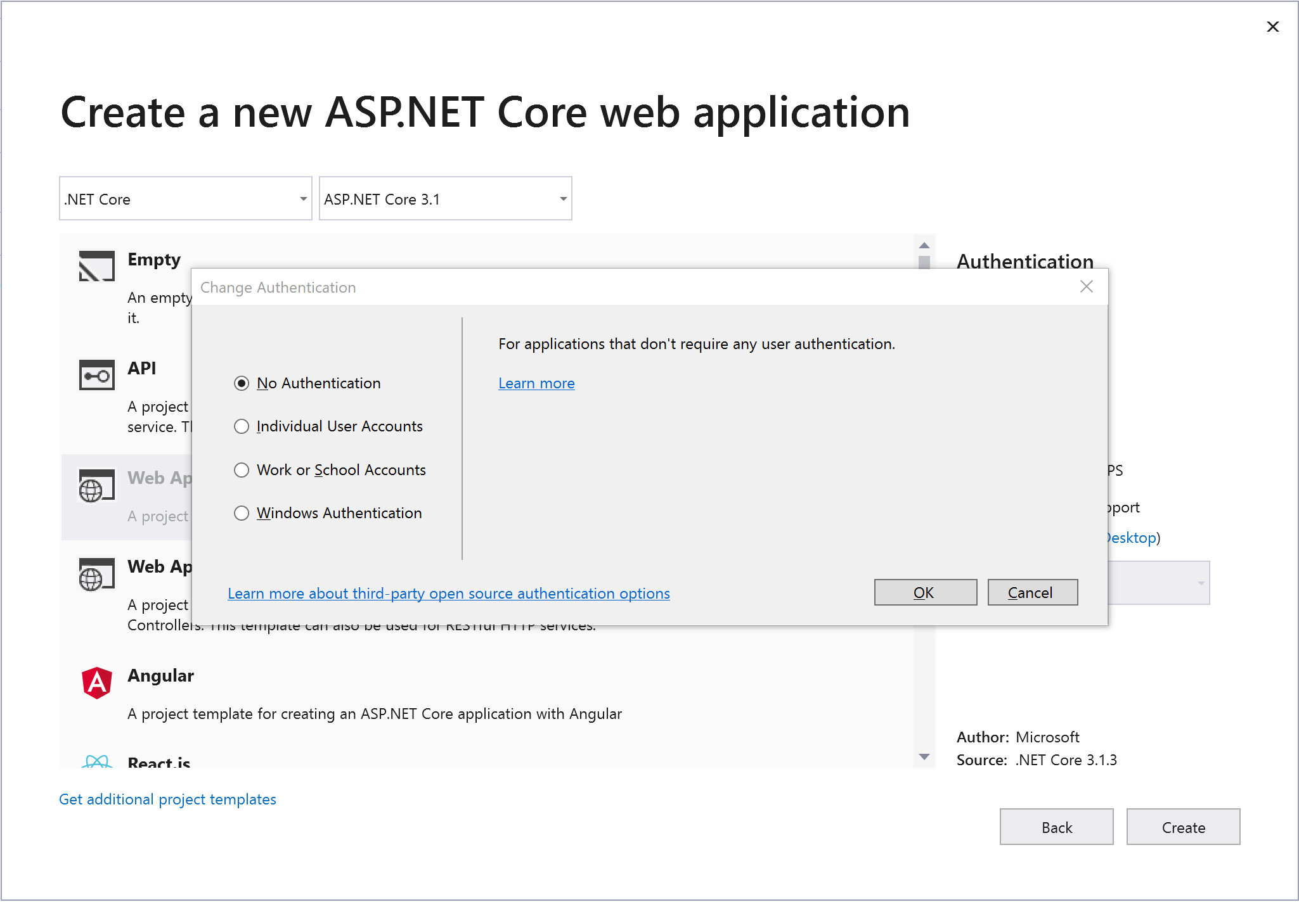
ASP.NET Core Template Authentication Methods
Notes:
These are the Authentication options a developer can see when using the ASP.NET Core 2.0 Template in Visual Studio 2017. Each option is explained on the next slide.

Slide 12
ASP.NET Core Template Authentication Methods
No authentication
Individual User Accounts
Store user accounts in-app (ASP.NET Identity)
Connect to an existing user store in the cloud (OpenID compliant Identity Provider)
e.g., Azure AD B2C
Work or School Accounts
Active Directory
Azure Active Directory
Office 365
Windows Authentication
Internet Information Services (IIS) Windows Authentication module

Slide 13
Authorization
What can a user do?
Many strategies for approaching this important question:
Role-Based Authorization
Claims-Based Policy Authorization
Manual Custom Authorization
{
“userID”: “83b6734e”,
...
“role”: “SysAdmin”,
“canEditForm”: true,
“dob”: “1/1/1985”
}
👧
{
“userID”: “ba35b637”,
...
“role”: “SDET2”,
“canEditCode”: true,
“dob”: “1/1/1970”
}
👦

Slide 14
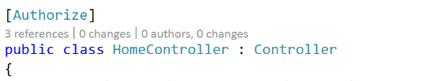
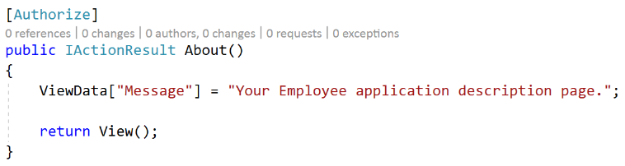
Authentication with [Authorize] attribute
[Authorize] attribute by itself is used to require an authenticated user
[Authorize] attribute can be used to restrict access to:
Specific action methods in a controller
Controller ➔ every action method within the controller
[Authorize] should be applied to each controller/action except login/register methods
Controller
Action
Notes:
Discus how [Authorize] attribute enables authentication.
[Authorize] can be used to do Role-, Claims-, and Policy-based access authorization

Slide 15
Demo: ASP.NET MVC Authentication
Notes:
Demo 0 Script:
Create a new ASP.NET Core application with individual user accounts and run it.
Navigate to Privacy page. Any user can navigate to it without logging in.
Stop the app and go to HomeController.cs
Apply [Authorize] attribute to Privacy action method.
Run the app. Click Privacy in the header and it should request the user to log in this time.

Slide 16
Module 9: Security
Section 2: ASP.NET Identity
Lesson: Overview

Slide 17
History of ASP.NET Account Services
Nov 2005 ASP.NET 2.0 – Introducing Membership!
Microsoft SQL Server, Microsoft SQL Server Express
May 2012 Universal Providers (First NuGet)
SQL CE, Azure, one provider to access all SQL
Aug 2012 Simple Membership
Sourced in Web Pages, came to MVC / Web Forms
Oct 2013 ASP.NET Identity v1
Completely new model
Mar 2014 ASP.NET Identity v2
Two factor, account lockout, confirmation, reset, etc.
Dec 2015 ASP.NET Core – Identity v3
Plumbing changes to work with ASP.NET Core

Slide 18
ASP.NET Identity Seamless and unified experience for enabling authentication in ASP.NET apps on-premises and in the cloud.
Notes:
ASP.NET Membership (http://msdn.microsoft.com/en-us/library/yh26yfzy(v=VS.100).aspx) was designed to solve site membership requirements that were common in 2005, which involved Forms Authentication, and a Microsoft SQL Server database for user names, passwords, and profile data. Today there is a much broader array of data storage options for web applications, and most developers want to enable their sites to use social identity providers for authentication and authorization functionality.
The assumption that users will log in by entering a user name and password that they have registered in your own application is no longer valid. The web has become more social. Users are interacting with each other in real time through social channels such as Facebook, Twitter, and other social web sites. Developers want users to be able to log in with their social identities so that they can have a rich experience on their web sites. A modern membership system must enable redirection-based log-ins to authentication providers such as Facebook, Twitter, and others.

Slide 19
ASP.NET Identity
Easily pluggable user profile
Complete control over the schema of user and profile information
Persistence control
SQL Server (Default), Microsoft SharePoint, Azure Storage Table Service, NoSQL databases
Role Provider
Role-based authorization
Claims-based Authentication
Includes rich information about user’s identity
Notes:
One ASP.NET Identity system
ASP.NET Identity can be used with all of the ASP.NET frameworks, such as ASP.NET MVC, Web Forms, Web Pages, Web API, and SignalR.
ASP.NET Identity can be used when you are building web, phone, store, or hybrid applications.
Ease of plugging in profile data about the user
You have control over the schema of user and profile information. For example, you can easily enable the system to store birth dates entered by users when they register an account in your application.
Persistence control
By default, the ASP.NET Identity system stores all the user information in a database. ASP.NET Identity uses Entity Framework Code First to implement all of its persistence mechanism.
Since you control the database schema, common tasks such as changing table names or changing the data type of primary keys is simple to do.
It is easy to plug in different storage mechanisms such as SharePoint, Azure Storage Table Service, NoSQL databases, etc., without having to throw System.NotImplementedExceptions exceptions.
Role provider
There is a role provider which lets you restrict access to parts of your application by roles. You can easily create roles such as “Admin” and add users to roles.
Claims Based
ASP.NET Identity supports claims-based authentication, where the user’s identity is represented as a set of claims. Claims allow developers to be a lot more expressive in describing a user’s identity than roles allow. Whereas role membership is just a boolean (member or non-member), a claim can include rich information about the user’s identity and membership.

Slide 20
ASP.NET Identity
Unit Testability
Authentication/authorization logic independently testable
Social Login Providers
Microsoft account, Facebook, Google, Twitter, and others…
Azure AD
Single and multi-organization support
Azure AD B2C
Managed OAuth/OpenID compliant Identity provider
NuGet package
Agility in release of new features and bug fixes
Notes:
Unit testability
ASP.NET Identity makes the web application more unit testable. You can write unit tests for the parts of your application that use ASP.NET Identity.
Social Login Providers
You can easily add social log-ins such as Microsoft Account, Facebook, Twitter, Google, and others to your application, and store the user-specific data in your application.
Azure Active Directory
You can also add log-in functionality using Azure Active Directory, and store the user-specific data in your application. For more information, see Organizational Accounts in Creating ASP.NET Web Projects in Visual Studio 2013 ( http://www.asp.net/visual-studio/overview/2013/creating-web-projects-in-visual-studio)
OWIN Integration
ASP.NET authentication is now based on OWIN middleware that can be used on any OWIN-based host. ASP.NET Identity does not have any dependency on System.Web. It is a fully compliant OWIN framework and can be used in any OWIN hosted application.
ASP.NET Identity uses OWIN Authentication for log-in/log-out of users in the web site. This means that instead of using FormsAuthentication to generate the cookie, the application uses OWIN CookieAuthentication to do that.
NuGet package
ASP.NET Identity is redistributed as a NuGet package which is installed in the ASP.NET MVC, Web Forms and Web API templates that ship with Visual Studio 2013. You can download this NuGet package from the NuGet gallery.
Releasing ASP.NET Identity as a NuGet package makes it easier for the ASP.NET team to iterate on new features and bug fixes, and deliver these to developers in an agile manner.

Slide 21
Features
Two-Factor authentication
Email/phone verification
Roles and Claims
Profile
User Management
Role Management
Password policy enforcement
User password management
Account lockout
Extensibility

Slide 22
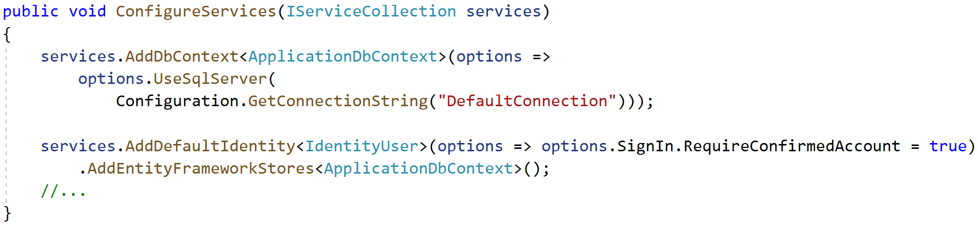
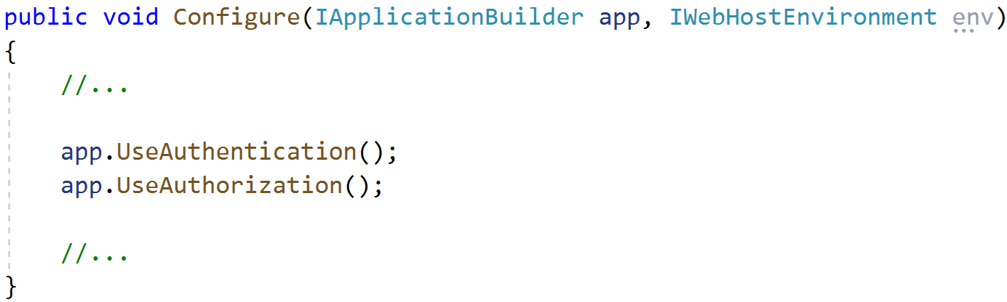
ASP.NET Identity Configuration
Startup.cs

Slide 23
Demo: ASP.NET Identity Configuration
Notes:
Demo Script:
Create a new ASP.NET Core application.
Since starter template is configured with ASP.NET Identity, open Startup.cs.
Explore ConfigureServices( ) method. Focus on Identity configuration methods.
Explore Configure( ) method.

Slide 24
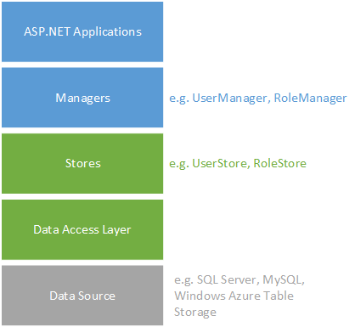
ASP.NET Identity Architecture
Managers
High-level classes
Operations such as create user
Completely decoupled from stores
Stores
Lower-level classes
Closely coupled with the persistent mechanism
Store users, roles, claims through Data Access Layer (DAL)
Notes:
ASP.NET Identity consists of classes called managers and stores. Managers are high-level classes which an application developer uses to perform operations, such as creating a user, in the ASP.NET Identity system. Stores are lower-level classes that specify how entities, such as users and roles, are persisted. Stores are closely coupled with the persistence mechanism, but managers are decoupled from stores which means you can replace the persistence mechanism without disrupting the entire application.
The following diagram shows how your web application interacts with the managers, and stores interact with the data access layer.
To create a customized storage provider for ASP.NET Identity, you have to create the data source, the data access layer, and the store classes that interact with this data access layer. You can continue using the same manager APIs to perform data operations on the user but now that data is saved to a different storage system.
You do not need to customize the manager classes because when creating a new instance of UserManager or RoleManager you provide the type of the user class and pass an instance of the store class as an argument. This approach enables you to plug your customized classes into the existing structure. You will see how to instantiate UserManager and RoleManager with your customized store classes in the section Reconfigure application to use new storage provider.
For more information, see: http://www.asp.net/identity/overview/extensibility/overview-of-custom-storage-providers-for-aspnet-identity

Slide 25
ASP.NET Identity Key Classes
IdentityUser – Represents web application user
EmailService, SmsService – Notified during two-factor authentication
UserManager – APIs to CRUD (Create, Read, Update, and Delete) user, claim, and auth information via UserStore
RoleManager – APIs to CRUD roles via RoleStore
UserStore – Talks to data store to store user, user login providers, user claims, user roles,
IUserStore, IUserLoginStore, IUserClaimStore, IUserRoleStore
RoleStore – Talks to the data store to store roles
SigninManager – High level API to sign in (single or two-factor)

Slide 26
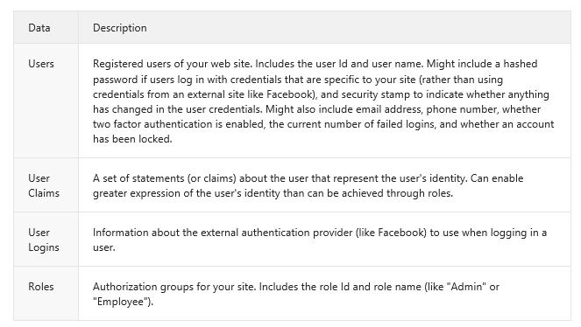
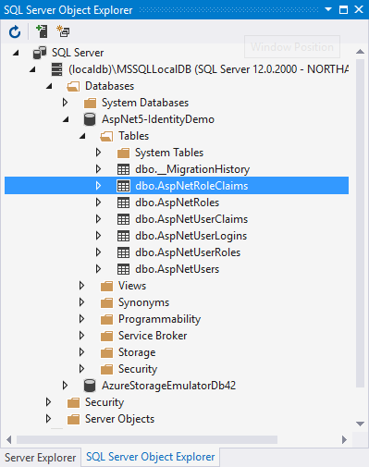
ASP.NET Identity Database
Notes:
This database is automatically created when identity database is initialized.

Slide 27
Demo: ASP.NET Identity Setup in Project Template
Notes:
Demo Script:
You already created new asp.net core project for previous demo
Open IdentityModel.cs.
Show ApplicationUser class. If you want to demo profile extension, add profile data for application users by adding properties to the ApplicationUser class.
Show ViewModels for Identity.
Open AccountController.cs and show how Identity is implemented in there. Focus on these areas:
Two-factor authentication
Email/SMS sending logic
External login logic
Open ManageController.cs and show how Manage User screen is implemented.

Slide 28
Module 9: Security
Section 3: Authorization
Lesson: Authorization Methodologies
Notes:
NOTE: Do the demo rather than show this section. If time is an issue, use the slides.

Slide 29
Roles-Based Authorization
[Authorize] attribute can be used to restrict access to specific users and roles
Restricting StoreManagerController to Administrators only
[Authorize(Roles = "Administrator")]
public class StoreManagerController : Controller
Restricting controller/action to any of multiple roles (logical OR)
[Authorize(Roles = "Administrator, SuperAdmin")]
public class StoreManagerController : Controller
Restricting controller/action to all of multiple roles (logical AND)
[Authorize(Roles = "Administrator”), Authorize(Roles = “SuperAdmin")]
public class StoreManagerController : Controller
Restricting controller/action to multiple users & roles
[Authorize(Users = “User1, User2", Roles = "SuperAdmin")]
public IActionResult Create(Album album)
Notes:
Roles are a specific type of claim
Run these as a demo live rather than kill by powerpoint
Discuss how [Authorize] attribute works.
Discuss about the following uses:
[Authorize(Roles=“Administrator”)]
[Authorize(Roles=“Administrator, SuperAdmin”)]
[Authorize(Users=“User1, User2”, Roles=“SuperAdmin”)]
In the same way, we can also restrict access to multiple users only.
Multiple Roles/Users listed in ONE [Authorize] are logically OR-ed. In order to signify a logical AND, you must stack multiple [Authorize] Attributes, e.g., in order to require that you are an Administrator AND a Executive you must go like this:
[Authorize(Roles = “Administrator”), Authorize(Roles = “Executive”)]

Slide 30
Claims-Based Policy Authorization - I
[Authorize] attribute can be used to restrict access to users with specific claims
Create a policy for requiring a claim or claim value
public void ConfigureServices(IServiceCollection services)
{
services.AddMvc();
services.AddAuthorization(options =>
{
options.AddPolicy("EmployeeOnly", policy => policy.RequireClaim("EmployeeNumber"));
options.AddPolicy(“FounderOnly”, policy =>
policy.RequireClaim(“EmployeeNumber”, “1”, “2”, “3”, “4”, “5”));
});
}
Startup.cs
Notes:
Discuss how [Authorize] attribute works.
Discuss about the following uses:
[Authorize(Roles=“Administrator”)]
[Authorize(Roles=“Administrator, SuperAdmin”)]
[Authorize(Users=“User1, User2”, Roles=“SuperAdmin”)]
In the same way, we can also restrict access to multiple users only.
Multiple Roles/Users listed in ONE [Authorize] are logically OR-ed. In order to signify a logical AND, you must stack multiple [Authorize] Attributes, e.g., in order to require that you are an Administrator AND a Executive you must go like this:
[Authorize(Roles = “Administrator”), Authorize(Roles = “Executive”)]

Slide 31
Claims-Based Policy Authorization - II
[Authorize] attribute can be used to restrict access to users with specific claims
Restricting controller/action to all of multiple Policies (logical AND)
[Authorize(Policy = “EmployeeOnly”), Authorize(Policy = “FounderOnly")]
public class StoreManagerController : Controller
Restricting controller/action to any of multiple Policies (logical OR)
[Authorize(Policy = “EmployeeOnly, FounderOnly")]
public IActionResult Create(Album album)
Notes:
Discuss how [Authorize] attribute works.
Discuss about the following uses:
[Authorize(Roles=“Administrator”)]
[Authorize(Roles=“Administrator, SuperAdmin”)]
[Authorize(Users=“User1, User2”, Roles=“SuperAdmin”)]
In the same way, we can also restrict access to multiple users only.
Multiple Roles/Users listed in ONE [Authorize] are logically OR-ed. In order to signify a logical AND, you must stack multiple [Authorize] Attributes, e.g., in order to require that you are an Administrator AND a Executive you must go like this:
[Authorize(Roles = “Administrator”), Authorize(Roles = “Executive”)]

Slide 32
Custom Policy Authorization - I
Implement IAuthorizationRequirement as a representation of the requirement
Does not need to actually contain any data or logic
public class MinimumAgeRequirement : IAuthorizationRequirement
{
public int MinimumAge { get; private set; }
public MinimumAgeRequirement(int minimumAge)
{
MinimumAge = minimumAge;
}
}
Notes:
Discuss how [Authorize] attribute works.
Discuss about the following uses:
[Authorize(Roles=“Administrator”)]
[Authorize(Roles=“Administrator, SuperAdmin”)]
[Authorize(Users=“User1, User2”, Roles=“SuperAdmin”)]
In the same way, we can also restrict access to multiple users only.
Multiple Roles/Users listed in ONE [Authorize] are logically OR-ed. In order to signify a logical AND, you must stack multiple [Authorize] Attributes, e.g., in order to require that you are an Administrator AND a Executive you must go like this:
[Authorize(Roles = “Administrator”), Authorize(Roles = “Executive”)]

Slide 33
Custom Policy Authorization - II
Inherit AuthorizationHandler<T> as a way to enact the requirement
Override the HandleRequirementAsync method
public class MinimumAgeHandler : AuthorizationHandler<MinimumAgeRequirement>
{
protected override Task HandleRequirementAsync(AuthorizationHandlerContext context,
MinimumAgeRequirement requirement)
{
if (!context.User.HasClaim(c => c.Type == ClaimTypes.DateOfBirth))
{
return Task.CompletedTask;
}
var dateOfBirth = Convert.ToDateTime(context.User.FindFirst(c =>
c.Type == ClaimTypes.DateOfBirth).Value);
// Calculate Age and determine if >= payload of MinimumAgeRequirement
// Return context.Succeed(requirement); if true!
}
Notes:
No real return value. We either complete the task without marking it succeeded or we return context.Succeed(requirement) which also completes the task

Slide 34
Custom Policy Authorization - III
Register the Authorization Handler in the IoC container
Add a policy to the Policy collection
public void ConfigureServices(IServiceCollection services)
{
services.AddMvc();
services.AddAuthorization(options =>
{
options.AddPolicy(“Over21", policy =>
policy.Requirements.Add(new MinimumAgeRequirement(21)));
});
services.AddSingleton<IAuthorizationHandler, MinimumAgeHandler>();
}
Startup.cs
Notes:
Note that we registered our authorization handler with the services container (this is a requirement)
This whole process can be done as a lambda expression if you’d rather

Slide 35
Custom Policy Authorization - IV
[Authorize] attribute can be used to restrict access to users that pass custom policies
Restricting controller/action to a custom policy (logical AND)
[Authorize(Policy = “Over21”)]
public class StoreManagerController : Controller

Slide 36
Demo: ASP.NET Core Identity
Notes:
Create an asp.net core v3.1 mvc application
Show Startup.cs methods
ConfigureServices() explain
services.AddDefaultIdentity
Configure() and explain
app.UseAuthentication();
app.UseAuthorization();
Show Areas and Identity content
Show ApplicationDbContext.cs and explain how it uses IdentityDbContext
Show the aspnet-identitymvc database and the schema that supports asp.net identity.
If time allows, add some security features like Password Recovery, Two factor authentication, etc

Slide 37
Module 9: Security
Section 4: OIDC (OpenID Connect) and OAuth 2.0
Lesson: Overview

Slide 38


OIDC (OpenID Connect) and OAuth 2.0
OIDC – Authentication protocol OAuth 2.0 – Authorization Protocol
Notes:
OAuth2.0 is not an authentication protocol and only designed for consent and not designed for the user authentication.
OpenID Connect is an authentication protocol and based on OAuth2.0
All Social authentication channels like Google, Facebook, Twitter etc. have their own versions of how to use OAuth for authentication. If you are a developer and you get many different ways of doing something is a pain. Here comes OpenID Connect that added the identity layer on top of OAuth and provide a standard that industry can use.
OpenID Connect is a standard way of using OAuth for authentication
OIDC verifies person’s identity and OAuth verifies person’s attributes

Slide 39
OpenID Connect and OAuth 2.0
OAuth 2.0 is purely for authorization, not authentication
OAuth 2.0 does not tell the client who the user is
Person granting access might not be the real user (resource owner)
Does not have a notion of an "identity“
Access Token contains claims about the delegated access rights
OpenID Connect builds on OAuth 2.0 and adds authentication information
OIDC add user identity request to OAuth 2.0 request
ID Token: JWT with at least a “sub” claim to identify the end user (“subject”)
UserInfo Endpoint: returns more claims about the end user (JSON/JWT)
OIDC is pure authentication protocol if access token is not requested

Slide 40
Terminology
Resource Owner
Owner of the requested resource
Typically the user of the application
E.g. “Owner of the OneDrive account/photos”
Authorization Server
Issues access tokens to clients
Authenticates resource owners
Gets access consent from the resource owner
Could be “Photo library provider”
Client
Application that needs to use the resource
Various types –
browser-Web-App, Native, Daemons, etc.
Often end-user facing
E.g. Snapfish “Print shop” application
Resource Server
Hosts the resource
Typically an API provider
E.g., Microsoft Graph API
Trusts tokens from an Authorization Server
E.g. OneDrive “Photo library”

Slide 41
OAuth 2.0 Flows
Authorization Code flow
Implicit Grant flow
Client Credentials flow
Resource Owner Password Credentials flow

Slide 42
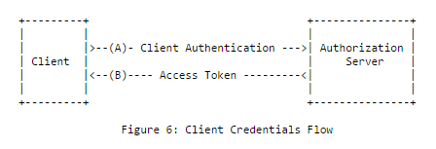
Client Credentials Flow
Confidential Clients Only
No human involved (batch service)
Should be used by confidential clients only

Slide 43
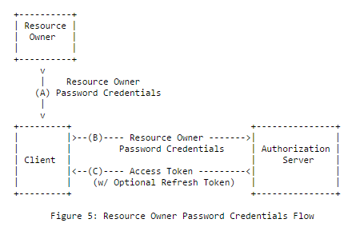
Resource Owner Password Credentials Flow
Client obtains Resource Owner’s Username and Password
Also useful to migrate from other protocols, like Basic Authentication
Should be used as last resort – considered an anti-pattern for user authentication

Slide 44
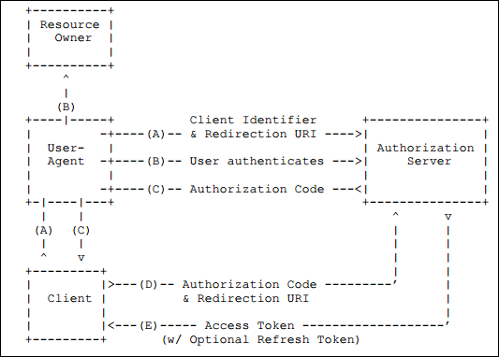
Authorization Code Flow
Obtain both access tokens and refresh tokens
Minimizes token exposure
Client must be capable of interacting with the resource owner's user-agent and capable of receiving incoming requests (via redirection) from the authorization server.

Slide 45
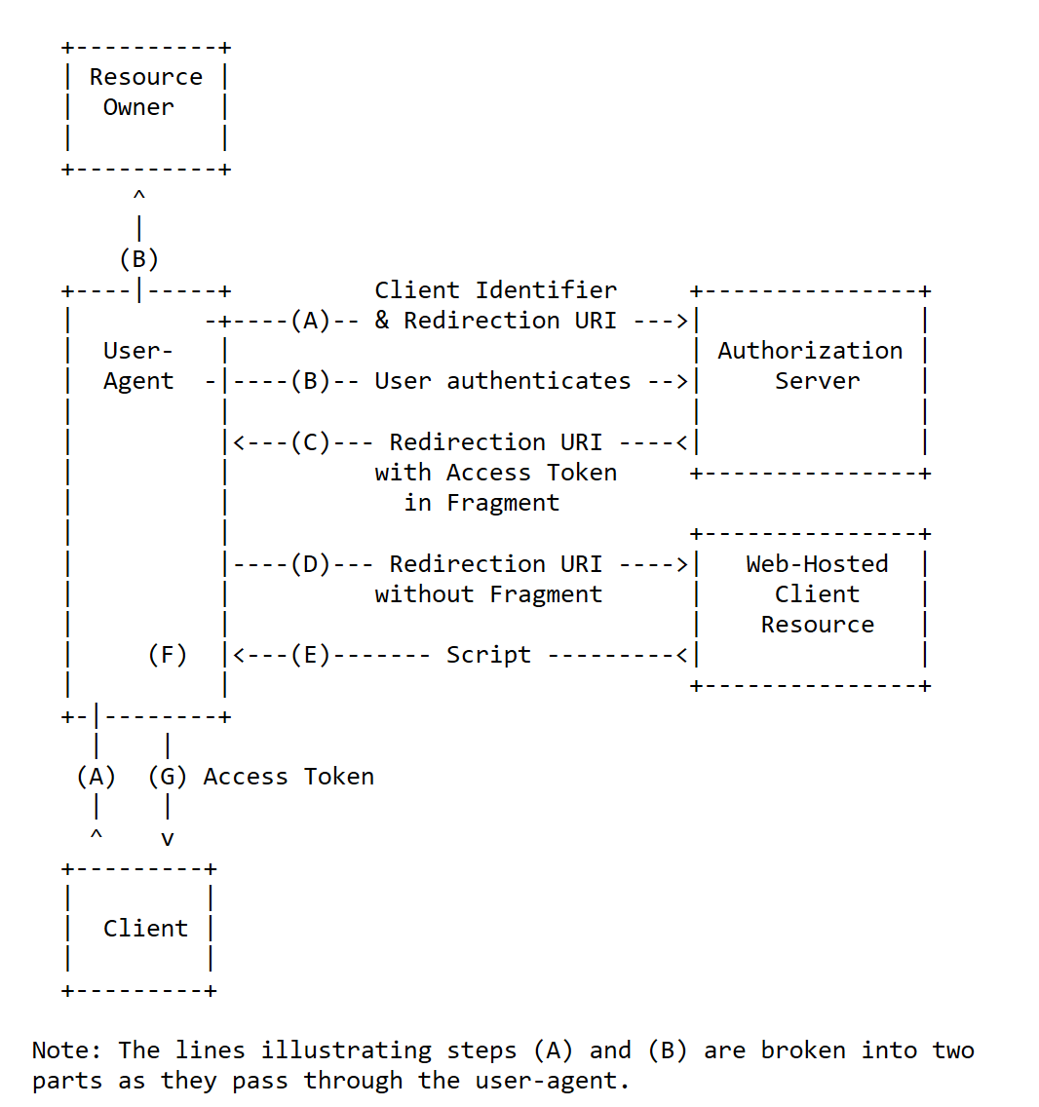
Implicit Grant Flow
For browser-based clients, e.g. SPA.
Browser code is the client needs to control server re-direction to avoid losing state

Slide 46
OIDC Flows
 | Authorization Code | Implicit Grant | Hybrid
All tokens returned from Authorization Endpoint | No | Yes | No
All tokens returned from Token Endpoint | Yes | No | No
Tokens sent via user agent | No | Yes | No
Clients can be authenticated (e.g. using client secret) | Yes | No | Yes
Can use refresh tokens | Yes | No | Yes
Communication in one round trip | No | Yes | No
Most communication server-to-server | Yes | No

Slide 47
OpenID Connect - Hybrid Flow
Hybrid Flow is a combination of Authorization Code Flow and Implicit Grant
Allows immediate use of an identity token and optionally retrieve an authorization code via one round trip to the STS
Confidential Clients Only
Can obtain an authorization code and tokens from the authorization endpoint and can also request tokens from the token endpoint.

Slide 48

Tokens
Access Token and ID Token
Access Token
Refresh Token
OIDC
OAuth 2.0
Can be obtained by both OIDC and OAuth 2.0 protocols
Notes:
OAuth only provides Access Token so there is no way from where the user information can be retrieved from
OIDC provides Access token plus ID token. ID token contains the user information
A Refresh Token is a special kind of token that can be used to obtain a renewed access token

Slide 49
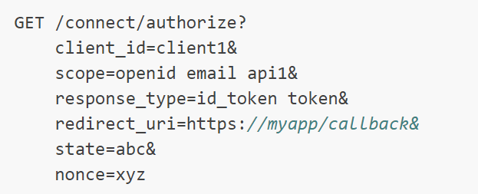
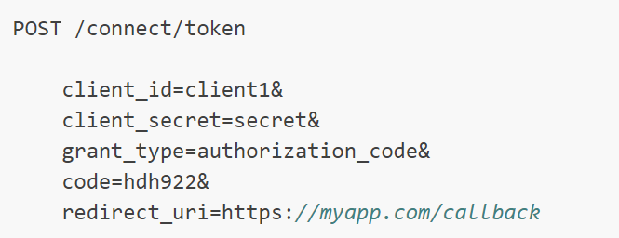
Endpoints
Authorize
Use to identity a user to obtain an authorization code
Later exchange for an Access Token
Token
Use this endpoint to access token
Supports password, authorization code,
client credentials and refresh tokens grant types

Slide 50
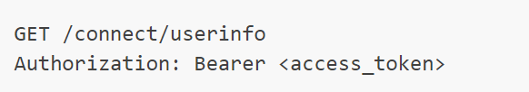
Endpoints
UserInfo
Can be used to retrieve identity information about a user
Caller needs to provide the valid access token
Discovery
To retrieve metadata about Identity Server
Provide information like issuer name, key material, supported scopes, etc.
E.g. https://contoso.com/.wellknown/openid-configuration

Slide 51
Demo: Integrate Azure AD into ASP.NET Core App using OpenID Connect middleware
Notes:
Demo Script:
Sign in to Azure Portal and access your active directory
Click on App Registration and create a new Application
Specify the Name, Application Type as Web app/API and Sign-on URL as http://localhost:44371/signin-oidc
Select create to register the app
Go to properties blade and set the Logout URL to http://localhost:44371/signout-oidc and select save
Note the Tenant ID (from the Endpoints blade, it’s a GUID defined in multiple endpoint URLs. All are same so note any one)
Note the App ID URI base URL
Note the Application ID (Client ID)
Open Visual Studio and go to the AADAuthOIDCDemo project
Walk through the Startup.cs, Extensions classes and appsettings.
Update the Domain, TenantID, ClientID as per your AAD configuration
Run the project, it will prompt to enter AAD credentials and finally login.

Slide 52
Module 9: Security
Section 5: External Identity Providers
Lesson: Identity as a Service

Slide 53
Identity Broker Pattern
A very powerful pattern for achieving Single Sign On (SSO) across all of your applications
This pattern is used by Social Identity Providers like Google, Facebook, Microsoft, etc.
OpenID and OAuth are examples of this pattern
Azure AD and Azure AD B2C are both OpenID/OAuth compliant, managed Identity Providers
👦

Slide 54
Identity Broker Pattern – Trusted Party
The Trusted party or Identity Provider is the source of truth for user Identities
A separate service from your applications
Can be hosted/managed or custom made
Allow Single Sign On (SSO)
Allows Identity to be “as a service”
“Sign in with…”
Microsoft Account
Work or School Account
Facebook
Google
Etc.

Slide 55
Identity Broker Pattern – Reliant Party
Your applications rely on the identity provider to verify user identities
Applications need to be registered with the Identity Provider in order to be reliant
Every application is uniquely identified by a Client ID or Application ID
Every application is verified via a public/private or shared key
Redirect authentication flows to the Identity Provider

Slide 56
Identity Broker Pattern – User
Users register with the Identity Provider (Trusted Party)
Attempts to access Reliant Party applications redirects the user to the Identity Provider for authentication
Once a user has a proof of Authentication, it can be used for all Reliant Party applications the user is authorized for
This creates Single Sign On!
👦

Slide 57
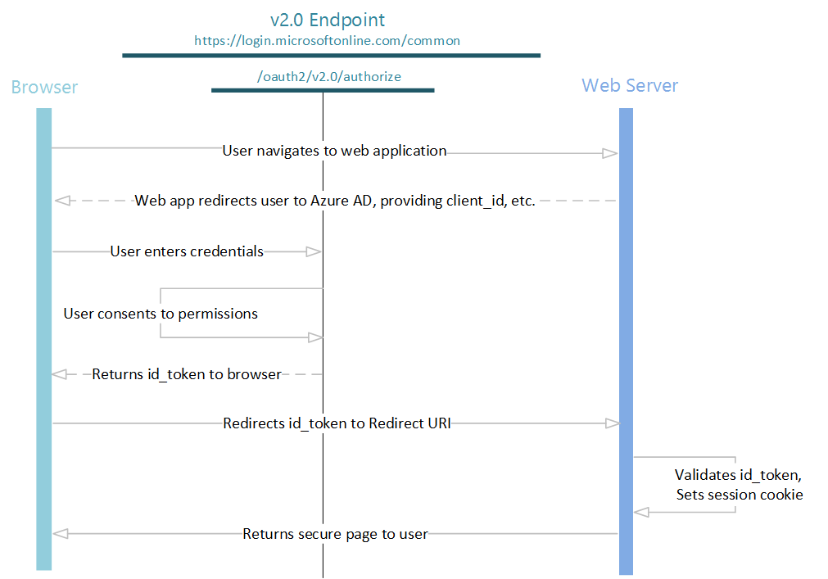
Identity Broker Pattern – OpenID
Notes:
Note that this is the same pattern for nearly all external providers, Facebook, Google, etc., included
Can be extended to protect Backend APIs and impersonate users through tiered applications

Slide 58
Authentication with External Providers
External providers
Facebook, Twitter, Microsoft, Google, etc.
Configuration
Application ID
Application Secret
Website URL
Storage of App Secret
Do not store in config file
[Best Practice] Secret Manger
[Best Practice] Application Settings in Azure
Notes:
The project created has the following code in Startup which reads the configuration values from a secret store. As a best practice, it is not recommended to store the secrets in a configuration file in the application since they can be checked into source control which may be publicly accessible

Slide 59
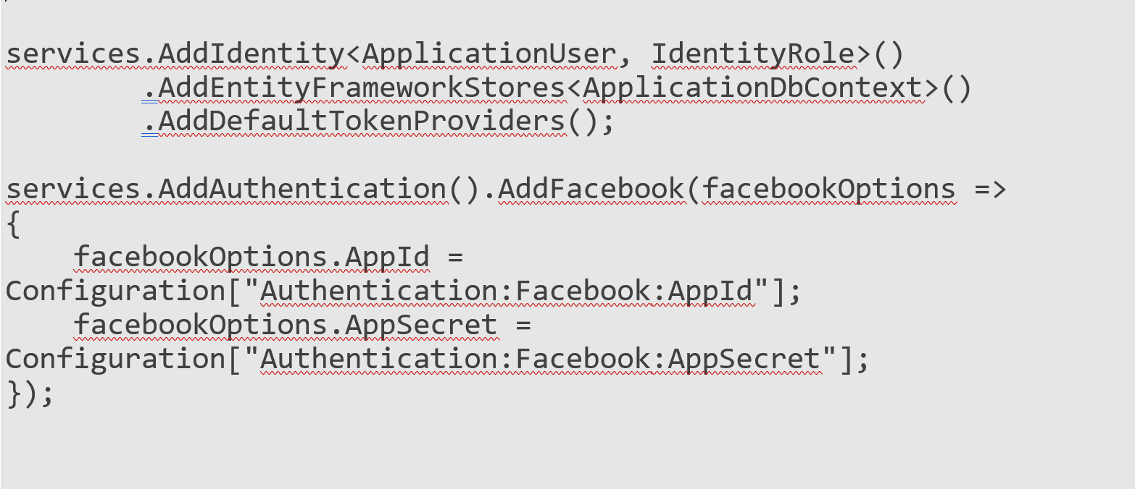
Authentication with Facebook
One of the external IdP can be Facebook. Use this guide to follow steps
Register App in Facebook
Install Microsoft.AspNetCore.Authentication.Facebook Nuget Package
dotnet add package Microsoft.AspNetCore.Authentication.Facebook
Modify Startup.cs/ConfigureServices() method:
Notes:
https://docs.microsoft.com/en-us/aspnet/core/security/authentication/social/facebook-logins?tabs=aspnetcore2x

Slide 60
Demo: Authentication Using External Provider
Notes:
Demo Script:
Authentication using Facebook middleware
https://docs.asp.net/en/latest/security/authentication/sociallogins.html
OR
Demo script on the next slide.

Slide 61
Demo
Double-click the box to open the demo script in PDF Reader

Slide 62
Module 9: Security
Section 6: ASP.NET Identity Strategies
Lesson: ASP.NET Identity Strategies

Slide 63
Recommendations
Utilize Secure Sockets Layer (TLS/SSL - HTTPS) everywhere
Attacker on network can steal your cookies and hijack your session
Yes, even login page needs to be protected
Any page user can access while logged in should be protected
Enforce a strong password policy (more an art than a science)
Use Cross-Site Request Forgery (CSRF) tokens everywhere for post methods
Do not allow unlimited login attempts
Brute forcers dream. Script kiddies abound.

Slide 64
Recommendations (continued)
If security requirements demand it, you can change password hashing method
Consider shortening OnValidateIdentity times to expire sessions
Two-Factor authentication is highly recommended for enhanced security
Did you just try to log in?
Yes! Here’s proof.

Slide 65
Note that…
Password expiration is not built-in
It is not right for every system, a good policy but consider it carefully
Identity is not multi-tenant or multi-app by default
Use Azure AD or add Tenant IDs to users for multi-tenancy
Put Identity in a separate SQL server to share across apps (not true SSO)

Slide 66
Module 9: Security
Section 7: Secret Management
Lesson: Secret Manager

Slide 67
Secret Manager
Environment variables are used to avoid storage of app secrets in code or in local configuration files
Connection Strings, Passwords, Certificates etc
Secret Manager
command line tool
stores sensitive data during the development of an ASP.NET Core project
local store: %APPDATA%\Microsoft\UserSecrets\<user_secrets_id>\secrets.json
user_secrets_id > UserSecretsId value specified in the .csproj file
In Production, use Azure Vault
Secret Manager is only for development
Notes:
Secret Manager
https://docs.microsoft.com/en-us/aspnet/core/security/app-secrets?view=aspnetcore-3.1&tabs=windows
Azure Vault
https://docs.microsoft.com/en-us/aspnet/core/security/key-vault-configuration?view=aspnetcore-3.1

Slide 68
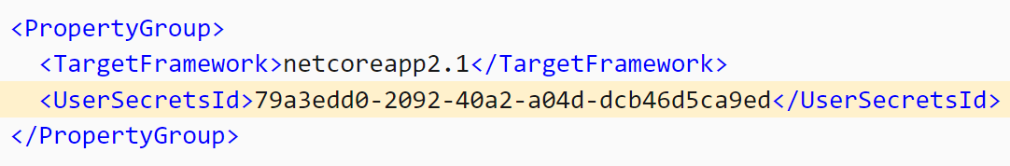
Secret Manager (continued)
To enable secret storage, run in cli
dotnet user-secrets init
UserSecretsId is added to .csproj file

Slide 69
Secret Manager (continued)
Set a secret
dotnet user-secrets set "Movies:ServiceApiKey" "12345“
List secrets
dotnet user-secrets list
Result ==== Movies:ConnectionString = Server=(localdb)\mssqllocaldb;Database=Movie-1;Trusted_Connection=True;MultipleActiveResultSets=true Movies:ServiceApiKey = 12345
Remove a secret
dotnet user-secrets remove "Movies:ConnectionString"

Slide 70
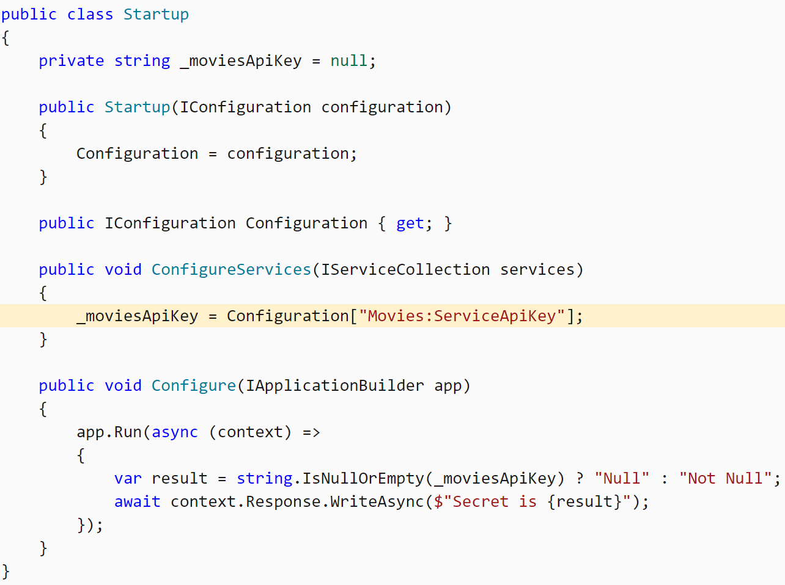
Secret Manager (continued)
User secrets can be retrieved via the Configuration API
Startup.cs

Slide 71
Demo: Secret Manager
Notes:
Create a new or reuse previous asp.net core 3.1 project
Add secret manager
Add secret
List secret
Optional: call secret in code

Slide 72
Module 9: Security
Section 8: Security Threats and Defenses
Lesson: Web Attacks and Defenses

Slide 73
ASP.NET Web Forms vs. ASP.NET MVC
ASP.NET Web Forms have automated protections
ViewState encryption and validation
Automatic request and event validation
ASP.NET MVC provides more granular control over security protections
HTML-encoding
Request validation
Controller/action level authorization
Custom security attribute, etc.
Notes:
Compare the built-in automatic protections provided by ASP.NET Web Forms and the protections provided by ASP.NET MVC.
ASP.NET MVC does not have as many automated protections as ASP.NET web forms do. However, ASP.NET MVC gives more granular control over security protections than ASP.NET web forms.

Slide 74
Cross-Site Scripting (XSS) Attack
XSS vulnerability allows an attacker to inject malicious JavaScript into pages generated by a web application
Malicious script executes in victim client’s browser
To gain access to sensitive webpage content, session cookies, etc.
Methods for injecting malicious code:
Active or Reflected Injection
Attack script directly reflected back to the user from the victim site
Victim user participates directly in the attack
Often done through social engineering tricks, such as malicious email
Passive or Stored Injection
Malicious code is saved in the backend database using user input
Potentially more dangerous because all users of the web application may be compromised
Notes:
XSS remains to be the most common attack on the web. Attack ratio: 80% on the web.
In XSS, malicious code executes in client browser to gain access to sensitive webpage content, session cookies, and other information.
Active or Reflected injection is also called Non-persistent XSS attack. On the other hand, Passive or Stored injection is also called persistent XSS attack.
Reflected attack is normally carried out through social engineer tricks or neutral website where malicious links are placed. Users are normally targeted through emails, etc.
On the other hand, passive injection may affect all users visiting the website since the malicious code is stored in the backend database.

Slide 75
XSS Reflected Attack
1. Collects email address
Mallory
(Attacker)
2. Sends malicious email
5. Valuable data (e.g. cookie) sent
Alice
(Victim)
3. Clicks on malicious link
4. Corrupt webpage downloaded
Bob’s Website
(Victim Server)
Notes:
Alice often visits a particular website, which is hosted by Bob. Bob's website allows Alice to log in with a username/password pair and stores sensitive data, such as billing information.
Mallory observes that Bob's website contains a reflected XSS vulnerability.
Mallory crafts a URL to exploit the vulnerability, and sends Alice an email, enticing her to click on a link for the URL under false pretenses. This URL will point to Bob's website (either directly or through an iframe (http://en.wikipedia.org/wiki/Iframe) or Ajax (http://en.wikipedia.org/wiki/Ajax_(programming)), but will contain Mallory's malicious code, which the website will reflect.
Alice visits the URL provided by Mallory while logged into Bob's website.
The malicious script embedded in the URL executes in Alice's browser, as if it came directly from Bob's server (this is the actual XSS vulnerability). The script can be used to send Alice's session cookie to Mallory. Mallory can then use the session cookie to steal sensitive information available to Alice (authentication credentials, billing info, etc.) without Alice's knowledge.
For more information, see: http://en.wikipedia.org/wiki/Cross-site_scripting

Slide 76
XSS Stored Attack
Mallory
(Attacker)
5. Session cookie stolen & sent
Alice
(Victim)
6. Mallory hijacks Alice’s session & impersonates her
1. Posts malicious message
3. Alice visits the website
4. Malicious code to browser
Bob’s Website
(Victim Server)
2. Malicious message saved in website’s DB
Notes:
Mallory posts a message with malicious payload to a social network.
When Alice reads the message, Mallory's XSS steals Alice's cookie.
Mallory can now hijack Alice's session and impersonate Alice to Bob’s website.
For more information, see: http://en.wikipedia.org/wiki/Cross-site_scripting

Slide 77
XSS Defense
Never trust any input to your website
Ensure that your app validates all user input, form values, query strings, cookies, information received from third-party sources, for example, OpenID
Use whitelist approach instead of trying to imagine all possible hacks
It is not possible to know all permutations
Remove/encode special characters
HTML encoding
JavaScript encoding
Notes:
XSS is the most frequent and one of the most dangerous attacks against web applications. To defend against it, you should:
Never trust any input to your website.
Ensure that your application validates all user input, form values, query strings, cookies, and information received from third-party sources, such as OpenID.
Use whitelist approach instead of trying to imagine all possible hacks (as Anti-XSS does)
Encode all input/output
Do not try to reinvent the wheel; use standard security libraries available, such as Anti-XSS library.

Slide 78
HTML Encoding
All output on your pages should be HTML-encoded or HTML-attribute-encoded
@Html.Encode(Model.FirstName)
@Model.FirstName
URL Encoding:
@Url.Encode(Url.Action(“index”, “home”, new {name=ViewData[“name”]}))
Razor View Engine automatically HTML-encodes output
Malicious User Input (without encoding)
HTML-Encoded User Input
HTML-Encoded User Input
<script>alert(“XSS!”)</script>
&lt;script&gt;alert(‘XSS!’)&lt;/script&gt;
Notes:
ASP.NET MVC automatically performs request validation against submitted values unless manually turned off.
All input and outputs on your webpages should be encoded.
<%: Model.FirstName %> is the short version of <% Html.Encode(Model.FirstName) %>
The Razor view engine HTML-encodes output by default, so a model property displayed using @Model.FirstName is automatically HTML-encoded by default without requiring any additional work.
Discuss what is HTML encoding and which attacks is it used against for defense measure.

Slide 79
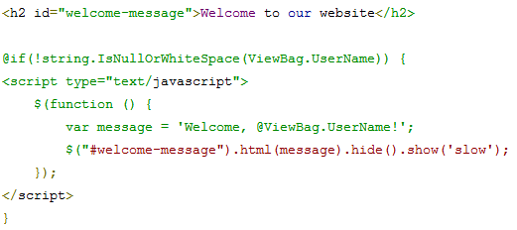
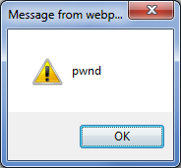
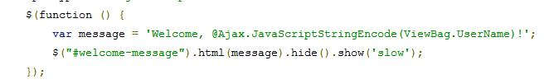

JavaScript Encoding
http://localhost:XXXXX/?UserName=Waqar\x3cscript\x3e%20alert(\x27pwnd\x27)%20\x3c/script\x3e
JavaScript Encoding Fix
Notes:
Just HTML-encoding everything is not necessarily enough. It may not be able to prevent malicious JavaScript from executing.
In the example above, malicious user posts HTML-encoded JavaScript code in the query string. Since the JavaScript code is using UserName value as is, the script executes and the alert message is displayed to the user. In real circumstances, the hackers will not show JavaScript alerts; in fact, they will silently steal user information or redirect them to another page.
JavaScript-encoding comes to the rescue. In the fixed code, we use @Ajax.JavaScriptStringEncode( ) method to encode the string that is consumed by JavaScript code. We could have used Anti-XSS library for the same. It is explained in the next slide.

Slide 80
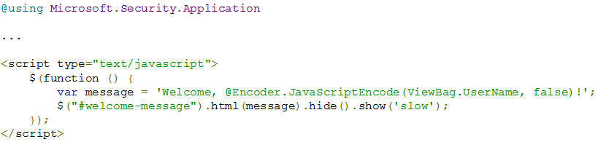
Anti-XSS Library
It provides a myriad of encoding functions for user input, including HTML, HTML attributes, XML, CSS and JavaScript
Whitelist Approach:
All characters not on the whitelist are encoded
JavaScript Encoding Fix with Anti-XSS Library
Notes:
There are a few important differences between Anti-XSS library and ASP.NET MVC encoding features:
Anti-XSS uses whitelist approach, i.e. all characters not on the white list will be encoded using the correct rules for the encoding type. Whilst this comes at a performance cost Anti-XSS has been written with performance in mind. On the other hand, ASP.NET MVC uses a limited blacklist of disallowed characters.
Anti-XSS library is focused on preventing security vulnerabilities in web applications, where as ASP.NET MVC encoding focuses primarily on display problems.

Slide 81
Demo: Cross-Site Scripting Attack
Notes:
Demo Script:
Open XSSDemo solution in Demos\Module 09 - Security\XSSDemo folder.
Run the application. Navigate to http://localhost:XXXXX/?userName=Waqar
Let us try to inject script now. Try this: http:///?username=<script>alert('pwnd')</script>
The attack will not work because Razor HTML encodes all content by default.
Since this value is being rendered via JavaScript, it is vulnerable to JavaScript encoding, which will not be picked up by the ASP.NET encoder. Try this url: http://localhost:XXXXX/?UserName=Waqar\x3cscript\x3e%20alert(\x27pwnd\x27)%20\x3c/script\x3e
XSS attack was successful.
How can we prevent it?
Let us use Microsoft Anti-XSS library to JSEncode it. Add Anti-XSS NuGet package if it is not there already.
Navigate to Index.cshtml file.
Replace JavaScript function line with the following: var message = 'Welcome, @Encoder.JavaScriptEncode(ViewBag.UserName, false)!';
Let us try the following URL. It should have no effect now. http://localhost:XXXXX/?UserName=Waqar\x3cscript\x3e%20alert(\x27pwnd\x27)%20\x3c/script\x3e
Now that we have put in JavaScript encoding, if you try the earlier URL. It leads to XSS attack~ http://localhost:XXXXX/?username=<script>alert('pwnd')</script>
In order to deal with both scenarios, HTML and JavaScript encode the string by replacing the code with the following: var message = "Welcome, @Encoder.JavaScriptEncode(@Encoder.HtmlEncode(ViewBag.UserName), false)!";

Slide 82
Cross-Site Request Forgery (CSRF) Attack
CSRF attack tricks a browser into misusing its authority to represent a user to remote website
CSRF exploits user’s trust in a browser
Confused Deputy Attack against a web browser
Characteristics of “at-risk” sites:
Reliance on user identity
Perform actions on input from authenticated user without requiring explicit authorization
Notes:
CSRF attack: XSS plus a confused deputy.
Confused Deputy attack is described as, “A confused deputy is a computer program that is innocently fooled by some other party into misusing its authority. It is a specific type of privilege escalation.”
For more information, see: http://en.wikipedia.org/wiki/Confused_Deputy
It is important to note that a number of banking websites carry out important/sensitive functions through URL, such as follows:
http://somerandombank.example.com?function=transfer&amount=500&toaccountnumber=23234551235&from=checking
Using social engineering, a signed-in user with active session cookie in the browser may fall prey to this attack if his/her bank performs the funds transfer action without explicitly requiring user authorization. All the victim user would have to do in that case is to visit the webpage containing the above URL as the image source.

Slide 83
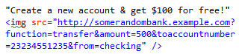
CSRF Attack (continued)
Alice
(Victim)
Mallory
(Attacker)
4. Cookie with auth. info still alive in client browser
1. Posts malicious message
6. Alice’s browser is tricked into submitting funds transfer request using cookie
5. User visits the forum
3. Logs into bank website
Some Random Bank
(Victim)
Public Forum Website
2. Malicious message saved in website’s DB
Notes:
Malicious user Mallory creates a public forum entry with a message, “Create a new account & get $100 for free!” along with an image tag as shown below. This is a benign social engineering attack example. More clever attacks can easily be thought of to trick the users. <img src="http://somerandombank.example.com?function=transfer&amount=500&toaccountnumber=23234551235&from=checking" />
The forum post is successfully saved in the backend database. Since the image URL is invalid for an image, it will be rendered as a broken red X along with the message. Normal users will assume that it is just a missing image and will simply ignore it.
Alice signs into her banking website.
Banking website creates a session cookie in Alice’s browser, which will remain valid until it is expired (usually after 15 minutes of inactivity).
Alice visits the public forum website containing a malicious image source URL. As soon as Alice lands on the malicious website, her browser will download the webpage and try to access the source of malformed image. As a result, the malicious URL will execute. If Alice’s bank website is not ensuring that she is on the other end, the funds transfer request will go through without her knowing about it. There she just became a perfect victim of CSRF attack!

Slide 84
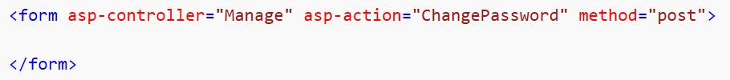
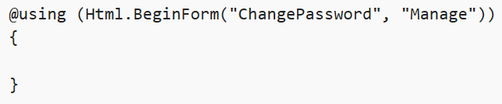
CSRF Defense
AntiForgery token: A hidden form field that is validated when the form is submitted
Both Html Helper and Tag Helper based forms will automatically create an AntiForgery token and include it as a hidden field
Notes:
There are two main ways to block CSRF:
Check that the incoming requests have a Referer header referencing your domain. This will stop requests unwillingly submitted from a third-party domain. However, some people disable their browser’s Referer header for privacy reasons, and attackers can sometimes spoof that header if the victim has certain versions of Adobe Flash installed. This is a weak solution.
Put a user-specific token as a hidden field in legitimate forms, and check that the right value was submitted. If, for example, this token is the user’s password, then a third-party cannot forge a valid form post, because they do not know each user’s password. However, do not expose the user’s password this way: Instead, it is better to use some random value (such as a GUID) which you have stored in the visitor’s Session collection or into a Cookie.
For more information, see: http://blog.stevensanderson.com/2008/09/01/prevent-cross-site-request-forgery-csrf-using-aspnet-mvcs-antiforgerytoken-helper/
This is an authorization filter that checks that:
The incoming request has a cookie called __RequestVerificationToken
The incoming request has a Request.Form entry called __RequestVerificationToken
These cookie and Request.Form values match
Assuming all is well, the request goes through as normal. But if not, there is an authorization failure with message “A required anti-forgery token was not supplied or was invalid”.
This prevents CSRF because even if a potential victim has an __RequestVerificationToken cookie, an attacker cannot find out its value, so they cannot forge a valid form post with the same value in Request.Form. But legitimate users are not inconvenienced at all; the mechanism is totally silent.

Slide 85
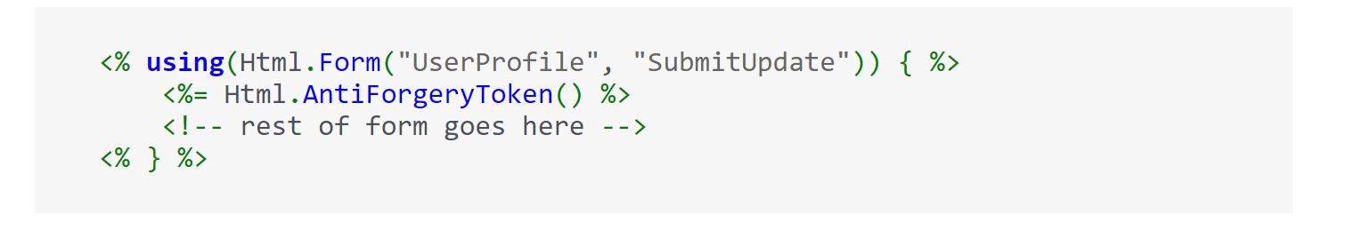
Syntax of the Anti-Forgery Token

Slide 86
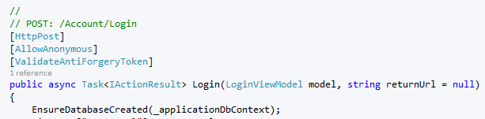
CSRF Defense
AntiForgery token: A hidden form field that is validated when the form is submitted
Validate the token on the server side via the [ValidateAntiForgeryToken]
Notes:
There are two main ways to block CSRF:
Check that the incoming requests have a Referer header referencing your domain. This will stop requests unwillingly submitted from a third-party domain. However, some people disable their browser’s Referer header for privacy reasons, and attackers can sometimes spoof that header if the victim has certain versions of Adobe Flash installed. This is a weak solution.
Put a user-specific token as a hidden field in legitimate forms, and check that the right value was submitted. If, for example, this token is the user’s password, then a third-party cannot forge a valid form post, because they do not know each user’s password. However, do not expose the user’s password this way: Instead, it is better to use some random value (such as a GUID) which you have stored in the visitor’s Session collection or into a Cookie.
For more information, see: http://blog.stevensanderson.com/2008/09/01/prevent-cross-site-request-forgery-csrf-using-aspnet-mvcs-antiforgerytoken-helper/
This is an authorization filter that checks that:
The incoming request has a cookie called __RequestVerificationToken
The incoming request has a Request.Form entry called __RequestVerificationToken
These cookie and Request.Form values match
Assuming all is well, the request goes through as normal. But if not, there is an authorization failure with message “A required anti-forgery token was not supplied or was invalid”.
This prevents CSRF because even if a potential victim has an __RequestVerificationToken cookie, an attacker cannot find out its value, so they cannot forge a valid form post with the same value in Request.Form. But legitimate users are not inconvenienced at all; the mechanism is totally silent.

Slide 87
Demo: Cross-Site Request Forgery Attack
Notes:
Demo Script:
Open solution CSRFDemo.sln in the Demos\Module 09 - Security\CSRFDemo folder for this module.
Run start the web application and login with an authorized user
If no user is available, create one using the Register link.
In order to create some test data, enter some string inputs in the textbox and click the Add Item button.
The added items will be displayed on the web page.
Navigate to wwwroot/UnknownSite.html in Visual Studio and set the URL port to your localhost, such as http://localhost:XXXXX/Home/IndexAdd
Open MS Edge dev tools (F12) and enable network tracing.
Add another item and investigate the network trace.
Highlight that there is an authentication cookie available (that authenticates the currently logged in user).
Have a look at the Request body and check out the data that was transmitted to the server.
Close the IE dev tools.
Right-click the Browse to unknown site and open this link in another tab.
Seems that nothing happened.
Go back to the previous tab and refresh the site.
An additional item is in the list (some item was added from the outside) Note: The item was added by the unknown site (which sent a copy of an legitimate request using different content data to the server). This is also possible form a different domain. Sending this request requires a valid authentication cookie (token). Since this cookie is automatically sent it can be used by other sites (on other browser tabs) as well.
Close the browser.
Let us fix CSRF with Antiforgery token:
In order to use an Anti-Forgery Token (in MVC) the following steps have to be made:
In the Index.cshtml page, use the Html.AntiForgeryToken() helper method to add an antiforgery token as a hidden field to the form.
Add @Html.AntiForgeryToken() in the using clause of “Html.BeginForm(“IndexAdd”, “Home”, FormMethod.Post))”
In the HomeController.cs, instruct ASP.NET to validate the form anti-forgery token with the anti-forgery token placed in the cookie.
Place the [ValidateAntiForgeryToken] attribute above the method “IndexAdd”
Run the web application and log in with valid user credentials
Enable the IE dev tools (F12) and enable network tracing.
Type a text in the text box and click Add Item.
Inspect the network trace (IE dev tools).
Have a look at the POST request (sent to “IndexAdd” and look into the request body). Besides the payload (“item=…”) there is an additional field called “__RequestVerificationToken”.
Open the Browse to unknown Site in a separate tab.
The user experience is the same as it was before.
Switch back to the other tab and refresh the page.
This time there is no additional (“You have been hacked item”) data item!
Go back to the other tab (displaying the malicious page”) and enable the IE dev tools.
Start the network trace.
Refresh this page.
Now you will see that a POST request was initiated but the receiving a response having the HTTP status code 500.
Check out the response body details and scroll down a little bit.
There you will find an error message that the antiforgery token was invalid / missing. Note: When the form was submitted from the attacker’s site, it was not able to come up with the correct Antiforgery token as a hidden field in the forms submission. This is the reason for the failed validation.
Close the browser.

Slide 88
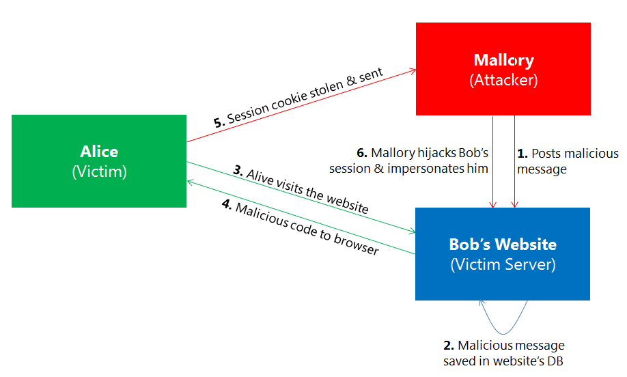
Cookie Stealing Attack
Attacker steals user's authentication cookie for a website to impersonate user and carry out actions on user's behalf
Dependent on XSS attack
Attacker must be able to inject script on the target site
Script sends user’s authentication cookie to attacker’s remote server
Notes:
Please refer to XSS Stored attack slide for description of the above diagram. It depicts both cookie stealing and Stored XSS attack.

Slide 89
Cookie Stealing Defense
Prevent XSS attack on the website
Disallow changes to the cookie from the client’s browser
Browser will invalidate the cookie unless the server sets/changes it
Can be done from web.config if using IIS
Can also be set when configuring Cookies in Startup.cs
Notes:
In order to defend against cookie stealing attack:
You should prevent XSS attack on your website. Refer to XSS defense slide for more information.
Disallow changes to the cookie from the client’s browser.
Browser will invalidate the cookie if anything but the server changes it or sets it.

Slide 90
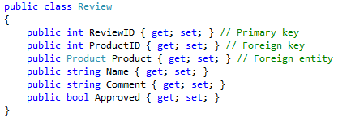
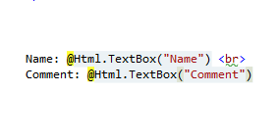
Over-Posting Attack
An attacker can populate model properties that are not included in the View.
Attacker can add “Approved=true” to form post.
Attacker can post values for Product, such as Product.Price, to change values in the persistent storage.
Model
View
Notes:
In the Review model, you can see that there are 6 fields. For a normal user, the view only shows two fields: name and comment assuming that the user will only need to use two fields to post a comment. However, a malicious user can easily meddle with the form post using web developer tool like Fiddler, and add “Approved=true” to the form post, which will automatically approve his/her comment. Even worse, attacker can post values, such as price, for a product to set the value as per her liking.

Slide 91
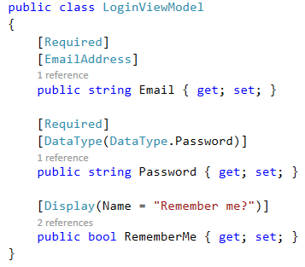
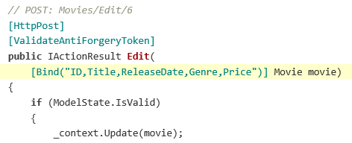
Over-Posting Defense
Use [bind] attribute to explicitly control the binding behavior
Specifically list permitted properties
Use View Model [recommended]
[Bind]
View Model
Notes:
There are two ways to defend against Over-Posting attack:
Using [Bind] attribute
Bind attribute can be placed on either model class or in the controller action parameter. You can use Bind in two ways:
White list approach: Specify all the fields you will allow binding to.
Black list approach: Specify all the fields that will be excluded from binding.
View Model:
In this approach, instead of binding directly to the data model, you can use View Model that will only hold those properties that you want the user to set.

Slide 92
Demo: Over-Posting Attack
Notes:
Demo Script:
OverPosting Attack
Open OverPostingDemo solution in Demos\Module 09 - Security\OverPostingDemo folder.
Navigate to Review.cs under Models folder. It contains all the fields for a user review.
Set a breakpoint on Index method in HomeController.cs.
Run Fiddler and monitor network traffic.
Run the application and submit user review comment along with user name.
Once the breakpoint is reached, show how the model object only contains the fields allowed by the app.
Find the request in the left-pane in Fiddler. Right-click on the request > Replay > Reissue and Edit.
Under Inspector tab in the right pane, go to Web Forms tab. Add a new field: NumberOfLikes and set it to 5000.
Execute the request. Click Break on Response to reach the breakpoint.
Navigate to breakpoint in HomeController.cs. Show the passed-in values of model object. It should have NumberOfLikes set to 5000, which will be inadvertently saved in the database.
How to defend against it?
We could either bind the method with a whitelist of entities, but using a ViewModel is a more recommended approach.
Replace Review parameter type in Index method with ReviewViewModel. This ensures that only the specified fields are passed to the controller.
Now if you make the same malicious request from Fiddler, it will have no effect on the server side.

Slide 93

SQL Injection
Malicious code is inserted into strings that are later passed to an instance of SQL Server (or other database).
http://xkcd.com/327/

Slide 94
Threat Defense Summary
Threat | Solution
Cross-Site Scripting (XSS) | HTML-encode all content JavaScript encoding
Cross-Site Request Forgery (CSRF) | AntiForgery token HTTPReferrer validation
Over-Posting | Bind attribute; ViewModels
Cookie Stealing | httpOnly cookies
SQL Injection | Constrain all input Use type-safe SQL parameters with stored procs Use parameters collection with dynamic SQL Use escape routines for special characters Least-privilege database account Escape wildcard characters Avoid disclosing error information
Notes:
Guide to SQL Injection
https://www.owasp.org/index.php/Guide_to_SQL_Injection
How To: Protect From SQL Injection in ASP.NET
http://msdn.microsoft.com/en-us/library/ff648339.aspx

Slide 95
Module 9: Security
Section 9: Trending Web Attacks
Lesson: OWASP Top 10

Slide 96
Open Web Application Security Project (OWASP) Top 10 Web Security Attacks (2017)
Injection
Broken Authentication
Sensitive Data Exposure
XML External Entities
Broken Access Control
Security Misconfiguration
Cross-Site Scripting (XSS)
Insecure Deserialization
Using Components with Known Vulnerabilities
Insufficient Logging & Monitoring
Notes:
OWASP Top 10 Application Security Risks - 2017
A1:2017-Injection
Injection flaws, such as SQL, NoSQL, OS, and LDAP injection, occur when untrusted data is sent to an interpreter as part of a command or query. The attacker’s hostile data can trick the interpreter into executing unintended commands or accessing data without proper authorization.
A2:2017-Broken Authentication
Application functions related to authentication and session management are often implemented incorrectly, allowing attackers to compromise passwords, keys, or session tokens, or to exploit other implementation flaws to assume other users’ identities temporarily or permanently.
A3:2017-Sensitive Data Exposure
Many web applications and APIs do not properly protect sensitive data, such as financial, healthcare, and PII. Attackers may steal or modify such weakly protected data to conduct credit card fraud, identity theft, or other crimes. Sensitive data may be compromised without extra protection, such as encryption at rest or in transit, and requires special precautions when exchanged with the browser.
A4:2017-XML External Entities (XXE)
Many older or poorly configured XML processors evaluate external entity references within XML documents. External entities can be used to disclose internal files using the file URI handler, internal file shares, internal port scanning, remote code execution, and denial of service attacks.
A5:2017-Broken Access Control
Restrictions on what authenticated users are allowed to do are often not properly enforced. Attackers can exploit these flaws to access unauthorized functionality and/or data, such as access other users’ accounts, view sensitive files, modify other users’ data, change access rights, etc.
A6:2017-Security Misconfiguration
Security misconfiguration is the most commonly seen issue. This is commonly a result of insecure default configurations, incomplete or ad hoc configurations, open cloud storage, misconfigured HTTP headers, and verbose error messages containing sensitive information. Not only must all operating systems, frameworks, libraries, and applications be securely configured, but they must be patched/upgraded in a timely fashion.
A7:2017-Cross-Site Scripting (XSS)
XSS flaws occur whenever an application includes untrusted data in a new web page without proper validation or escaping, or updates an existing web page with user-supplied data using a browser API that can create HTML or JavaScript. XSS allows attackers to execute scripts in the victim’s browser which can hijack user sessions, deface web sites, or redirect the user to malicious sites.
A8:2017-Insecure Deserialization
Insecure deserialization often leads to remote code execution. Even if deserialization flaws do not result in remote code execution, they can be used to perform attacks, including replay attacks, injection attacks, and privilege escalation attacks.
A9:2017-Using Components with Known Vulnerabilities
Components, such as libraries, frameworks, and other software modules, run with the same privileges as the application. If a vulnerable component is exploited, such an attack can facilitate serious data loss or server takeover. Applications and APIs using components with known vulnerabilities may undermine application defenses and enable various attacks and impacts.
A10:2017-Insufficient Logging&Monitoring
Insufficient logging and monitoring, coupled with missing or ineffective integration with incident response, allows attackers to further attack systems, maintain persistence, pivot to more systems, and tamper, extract, or destroy data. Most breach studies show time to detect a breach is over 200 days, typically detected by external parties rather than internal processes or monitoring.

Slide 97
ASP.NET Defenses Against OWASP Top 10 Attacks
Injection
Use parametrized SQL queries
Use parametrized APIs
Restricted binding of Action methods
Broken Authentication
Avoid using custom authentication modules
Sensitive Data Exposure
Use HTTPs
Encrypt data stored in application database(s)
Use strong encryption and hashing algorithms
Disable caching and autocomplete on sensitive forms
Notes:
Injection:
The preferred option is to use a safe API which avoids the use of the interpreter entirely or provides a parameterized interface. Be careful with APIs, such as stored procedures, that are parameterized, but can still introduce injection under the hood.
Broken Authentication
ASP.NET Identity
A single set of strong authentication and session management controls.
Sensitive Data Exposure:
Considering the threats you plan to protect this data from (for example, insider attack, external user), make sure you encrypt all sensitive data at rest and in transit in a manner that defends against these threats.
Do not store sensitive data unnecessarily. Discard it as soon as possible. Data you do not have cannot be stolen.
Ensure strong standard algorithms and strong keys are used, and proper key management is in place. Consider using FIPS 140 validated cryptographic modules.
Ensure passwords are stored with an algorithm specifically designed for password protection, such as bcrypt, PBKDF2, or scrypt.
Disable autocomplete on forms collecting sensitive data and disable caching for pages that contain sensitive data.

Slide 98
ASP.NET Defenses Against OWASP Top 10 Attacks (continued)
XML External Entities (XXE)
Use current versions of .NET which disables entity expansion by default
Broken Access Control
Except for public resources, deny by default
Implement access control mechanisms once and re-use them throughout the application, including minimizing CORS usage
Model access controls should enforce record ownership, rather than accepting that the user can create, read, update, or delete any record
Unique application business limit requirements enforced by domain models
Disable web server directory listing and ensure file metadata (e.g. .git) and backup files are not present within web roots
Log access control failures, alert admins when appropriate (e.g. repeated failures)
Rate limit API/controller access to minimize effect of automated attack tooling.
JWT tokens should be invalidated on the server after logout
Notes:
Insecure Direct Object References:
Use per user or session indirect object references. This prevents attackers from directly targeting unauthorized resources. For example, instead of using the resource’s database key, a drop down list of six resources authorized for the current user could use the numbers 1 to 6 to indicate which value the user selected. The application has to map the per-user indirect reference back to the actual database key on the server. OWASP’s ESAPI includes both sequential and random access reference maps that developers can use to eliminate direct object references.
Check access. Each use of a direct object reference from an untrusted source must include an access control check to ensure the user is authorized for the requested object.
Security Misconfiguration:
A repeatable hardening process that makes it fast and easy to deploy another environment that is properly locked down. Development, QA, and production environments should all be configured identically (with different passwords used in each environment). This process should be automated to minimize the effort required to setup a new secure environment.
A process for keeping abreast of and deploying all new software updates and patches in a timely manner to each deployed environment. This needs to include all code libraries as well (see new A9).
A strong application architecture that provides effective, secure separation between components.
Consider running scans and doing audits periodically to help detect future misconfigurations or missing patches.

Slide 99
ASP.NET Defenses Against OWASP Top 10 Attacks (continued)
Security Misconfiguration
Educate. Bridge the gap between Admins/Developers
SDL
Hardening Process
Patching Process
Release and Change Management
Solution Architecture (Infrastructure and Applications)
Scanning Tools, Monitoring Tools
Cross-Site Scripting (XSS)
All input must be validated against a whitelist of acceptable value ranges
Encode HTML context (body, attribute, JavaScript, CSS, or URL)
Use Content Security Policy
Protect your Cookies
Notes:
Missing Function Level Access Control:
Think about the process for managing entitlements and ensure you can update and audit easily. Do not hard code.
The enforcement mechanism(s) should deny all access by default, requiring explicit grants to specific roles for access to every function.
If the function is involved in a workflow, check to make sure the conditions are in the proper state to allow access.
CSRF:
The preferred option is to include the unique token in a hidden field. This causes the value to be sent in the body of the HTTP request, avoiding its inclusion in the URL, which is more prone to exposure.
XSS:
The preferred option is to properly escape all untrusted data based on the HTML context (body, attribute, JavaScript, CSS, or URL) that the data will be placed into. See the OWASP XSS Prevention Cheat Sheet for details on the required data escaping techniques.
Positive or “whitelist” input validation is also recommended as it helps protect against XSS, but is not a complete defense as many applications require special characters in their input. Such validation should, as much as possible, validate the length, characters, format, and business rules on that data before accepting the input.

Slide 100
ASP.NET Defenses Against OWASP Top 10 Attacks (continued)
Insecure Deserialization
Don’t use binary serializers on untrusted input (or at all, if possible)
Don’t allow type resolution for untrusted serialized objects
When deserializing, turn off all options that aren’t required by that application function. Generate and include the anti-XSRF tokens in all views
Using Components with Known Vulnerabilities
Regularly update application components
Formulate and enforce effective software security policy in your organization
Only obtain components from official sources over secure links
Subscribe to email alerts for security vulnerabilities related to components you use
Notes:
Using Components with Known Vulnerabilities:
Identify all components and the versions you are using, including all dependencies. (for example, the versions plugin).
Monitor the security of these components in public databases, project mailing lists, and security mailing lists, and keep them up-to-date.
Establish security policies governing component use, such as requiring certain software development practices, passing security tests, and acceptable licenses.
Where appropriate, consider adding security wrappers around components to disable unused functionality and/ or secure weak or vulnerable aspects of the component.

Slide 101
ASP.NET Defenses Against OWASP Top 10 Attacks (continued)
Insufficient Logging & Monitoring
Ensure all login, access control failures, and server-side input validation failures can be logged with sufficient user context to identify suspicious or malicious accounts and held for sufficient time to allow delayed forensic analysis
Ensure that logs are generated in a format that can be easily consumed by a centralized log management solutions (Semantic Logging)
Establish effective monitoring and alerting such that suspicious activities are detected and responded to in a timely fashion
Establish or adopt an incident response and recovery plan, such as NIST 800-61 rev 2 or later
Azure Monitor & Azure Sentinel

Slide 102
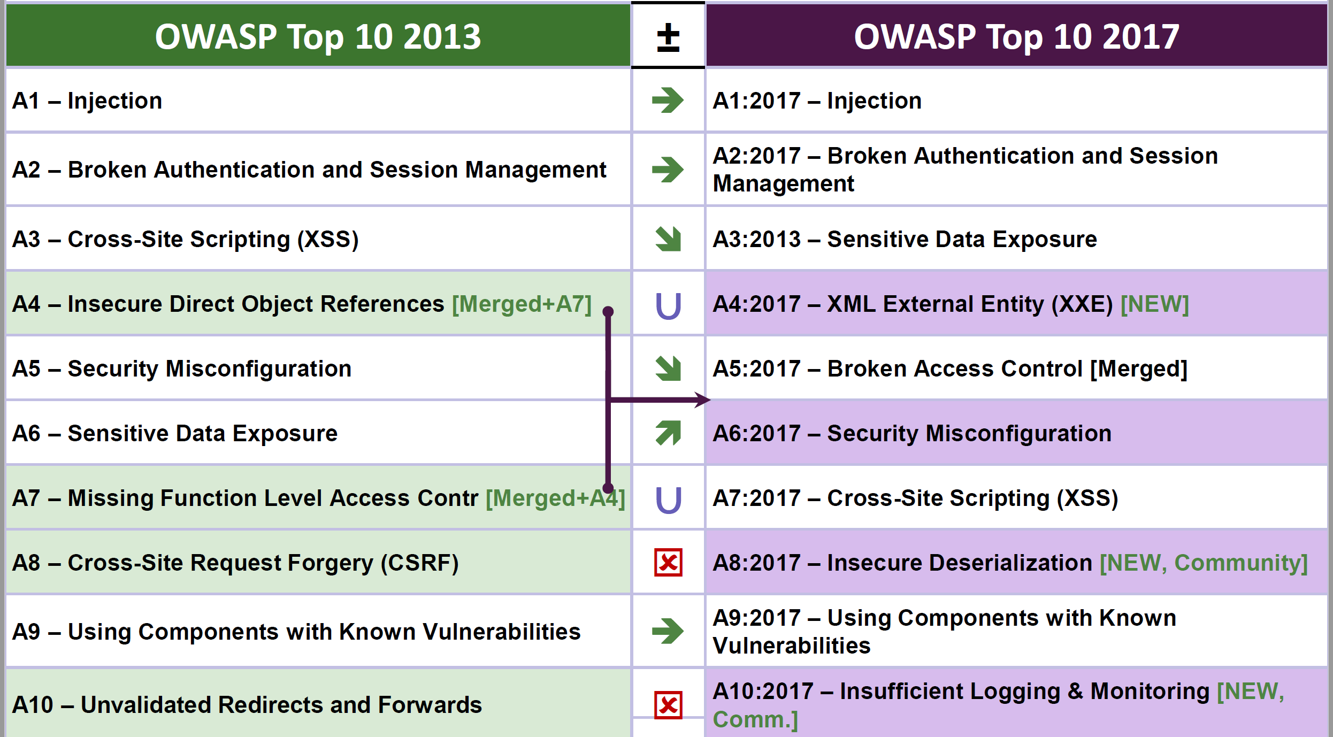
OWASP Top 10
Notes:
Explain OWASP Top 10 changes over time. Check if there is a new version
Open Web Application Security Project (OWASP)
For more information on the current web attack trends, review site and repository:
https://owasp.org/www-project-top-ten/OWASP_Top_Ten_2017/
https://github.com/OWASP/Top10
Or search with an online search engine for the latest OWASP Top 10 2017.
The image shown shows that the attacks A4 and A7 merged in 2017 to conform the A5: Broken Access Control.
Cross Site Request Forgery or Cross Site Forged Request was a type of attack with more occurrences in 2017 thus it jumped to position A7 from A8 in 2013.
In 2017 an additional attack was added -> A10:2017- Insufficient Logging and Monitoring.
A10 -> most attacks go un-noticed for several months (lack of monitoring) and unlogged. Having the logs for authentication and authorization can allow tracing back the time of the attack and the source.

Slide 103
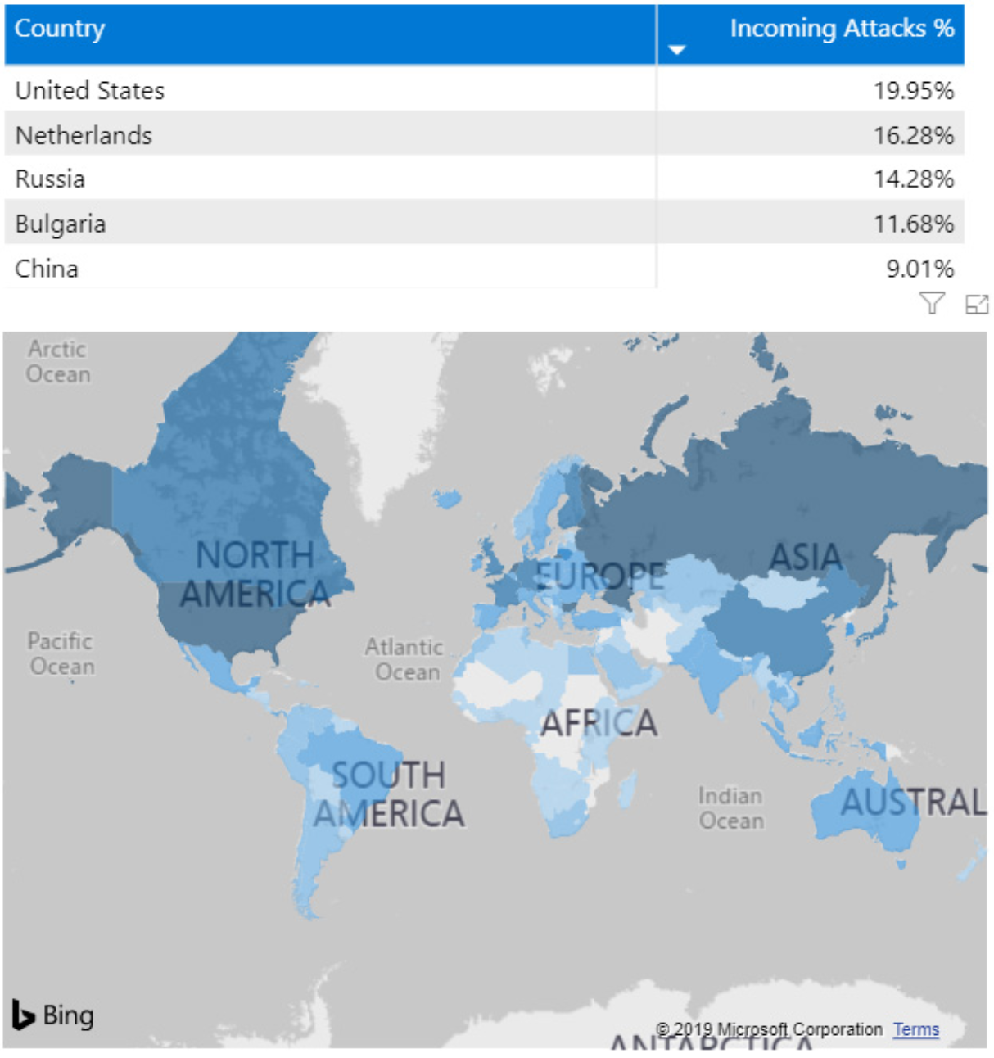
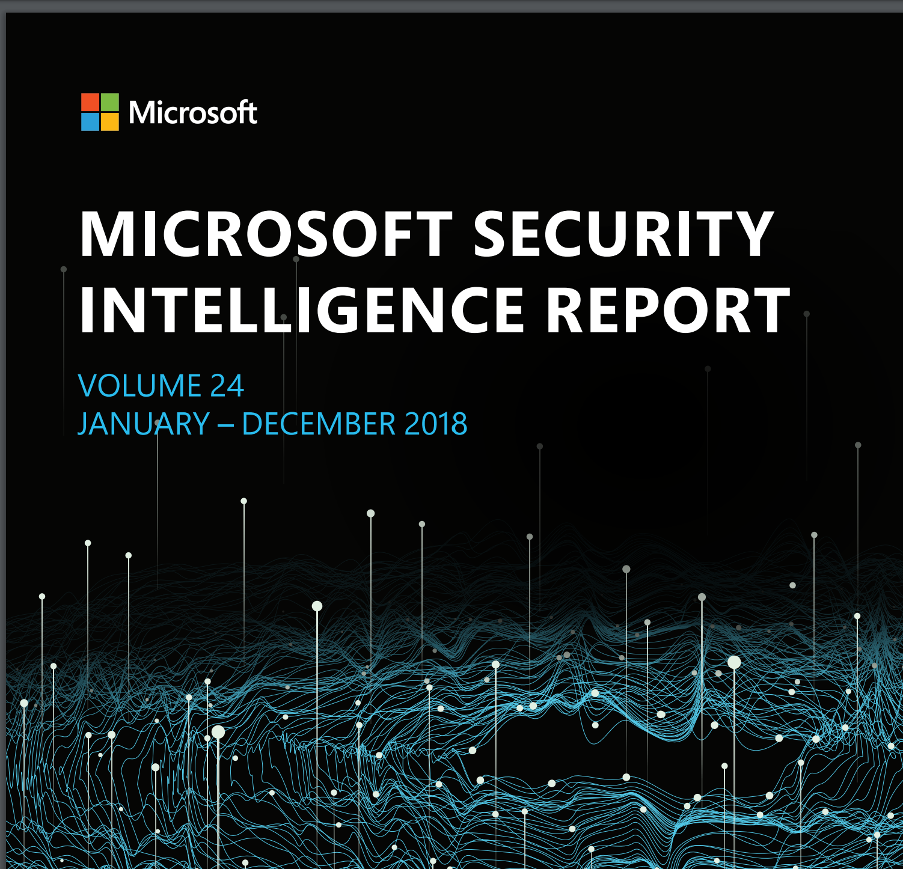
Microsoft Security Intelligence Report
Cloud provider related incoming attacks 2018
https://www.microsoft.com/en-us/security/operations/security-intelligence-report
https://www.microsoft.com/securityinsights/
Notes:
https://www.microsoft.com/securityinsights/: Interactive report
https://www.microsoft.com/en-us/security/business/security-intelligence-report
Document cybersecurity trends.
Updated on a year basis.
Additional security resources
Previous reports

Slide 104
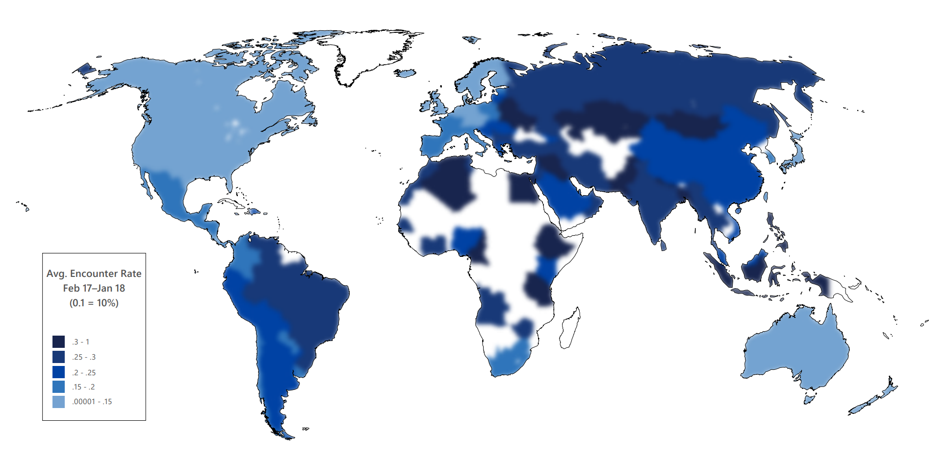
Encounter rates by country/region, February 2017-January 2018
Reference: Microsoft Security Intelligence Report, Volume 23

Slide 105
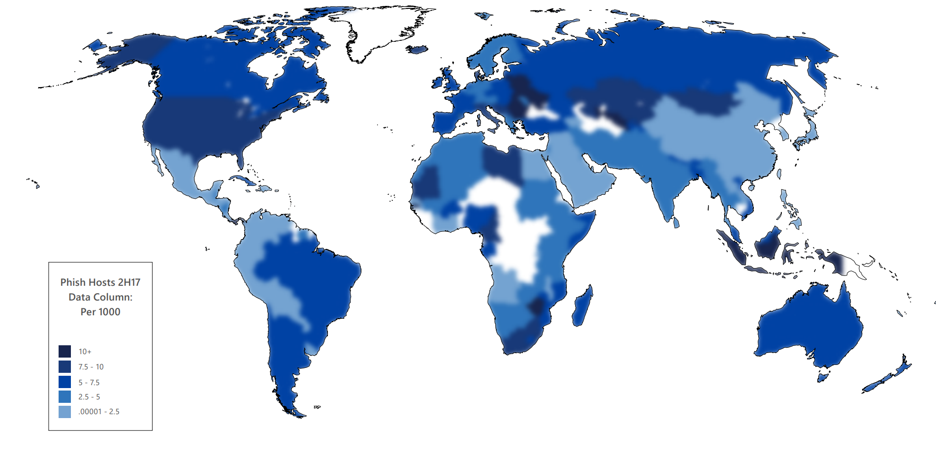
Phishing sites per 1,000 Internet hosts for locations around the world in 2H17
Reference: Microsoft Security Intelligence Report, Volume 23

Slide 106
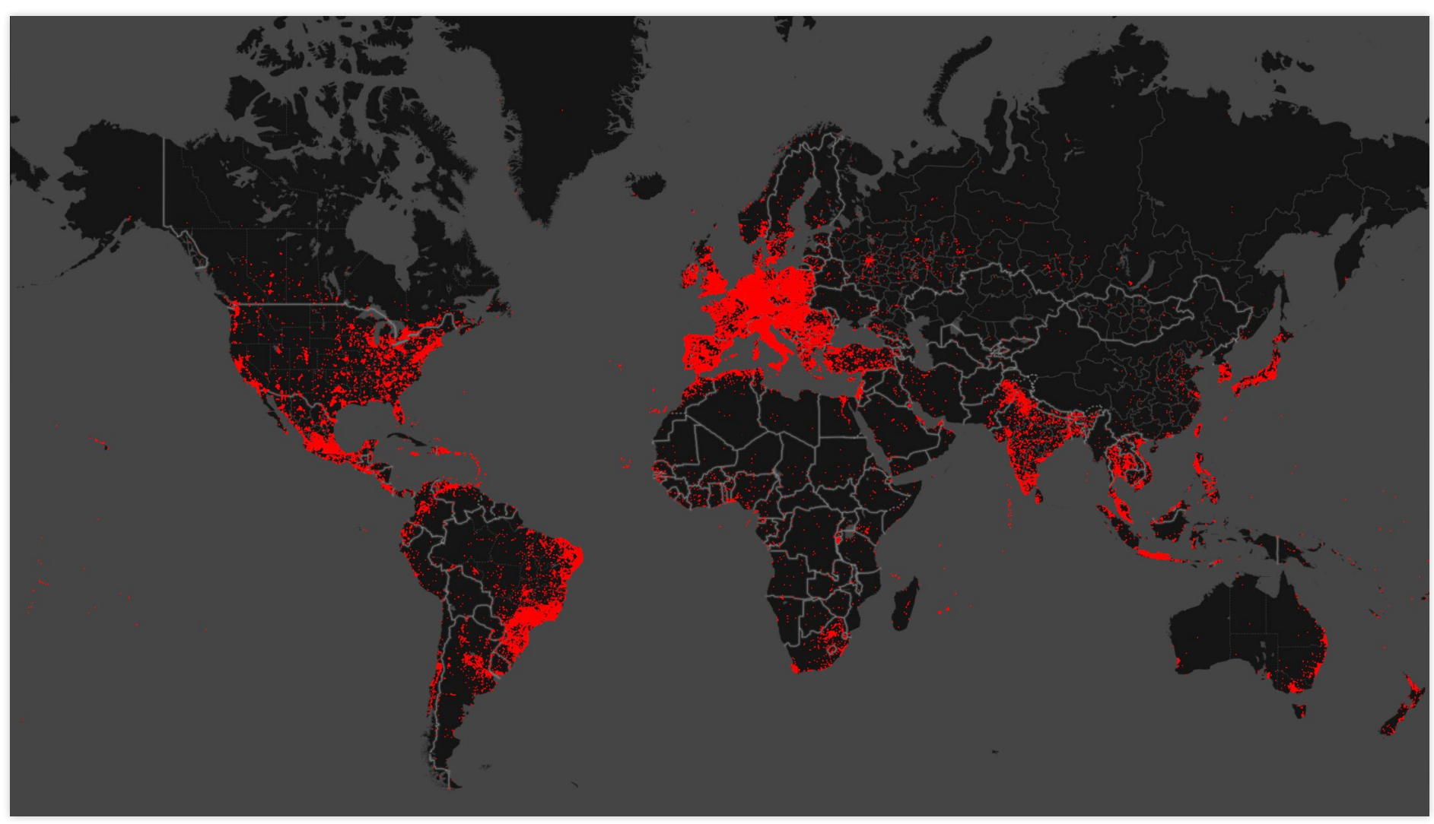
Gamarue’s global prevalence of infected devices from December 2017 to January 2018
Reference: Microsoft Security Intelligence Report, Volume 23
Notes:
DCU telemetry demonstrates Gamarue’s global prevalence of infected devices from December 2017 to January 2018
The Gamarue botnet Gamarue is known in the underground cybercrime market as the Andromeda bot. Like many other bots, Gamarue was advertised as a crime kit that hackers can purchase. The Gamarue crime kit includes the following components: The evolution of the Gamarue bot has been the subject of many thorough analyses by security researchers. At the time of disruption, there were five known active Gamarue versions: 2.06, 2.07, 2.08, 2.09 and 2.10. The latest and the most active is version 2.10. Figure 2. Gamarue bot-builder Interface ▪ A bot-builder, which builds the malware binary that infects computers ▪ A command-and-control application, which is a PHP-based dashboard application that allows hackers to manage and control the bots ▪ Documentation on how to create a Gamarue botnet

Slide 107
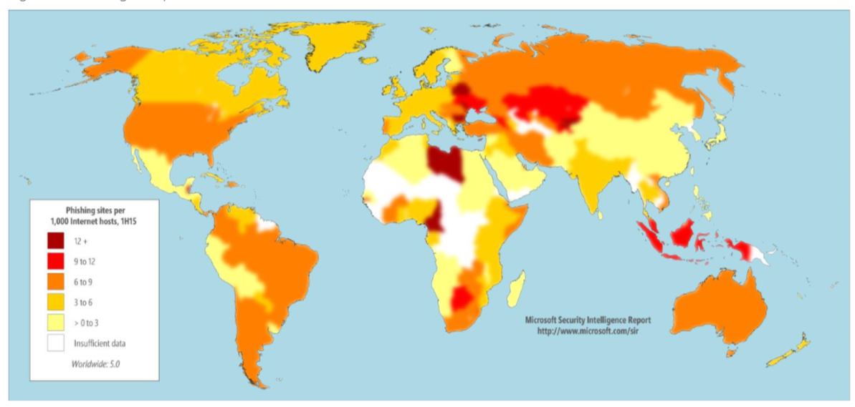
Phishing Sites Per 1000 Internet Hosts (2015 H1)
Reference: Microsoft Security Intelligence Report, Volume 19

Slide 108
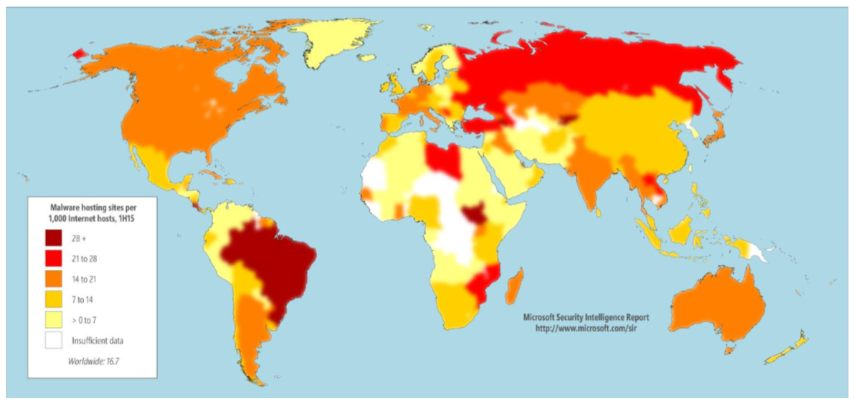
Global Distribution of Malware Hosting Sites (2015 H1)
Reference: Microsoft Security Intelligence Report, Volume 19

Slide 109
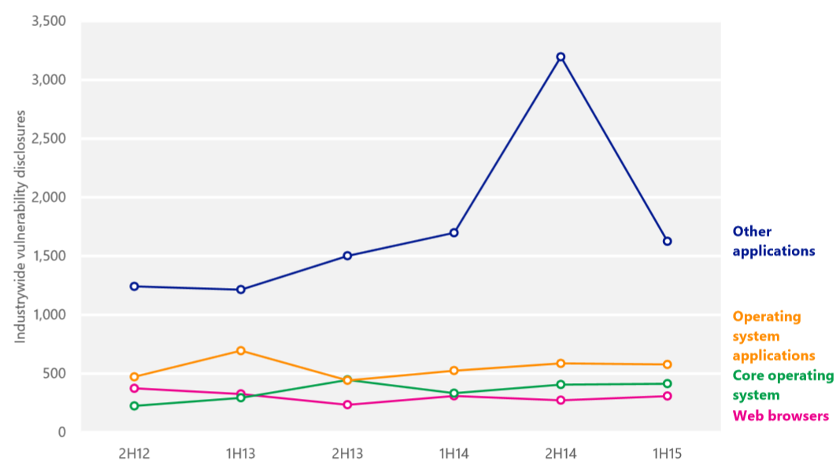
Vulnerability Trend
Reference: Microsoft Security Intelligence Report, Volume 19
Notes:
Core operating system vulnerabilities are those with at least one operating system platform enumeration (“/o”) in the National vulnerability Database (NVD) that do not have any application platform enumerations (“/a”).
Operating system application vulnerabilities are those with at least one /o platform enumeration and at least one /a platform enumeration listed in the NVD, except as described in the next bullet point.
Browser vulnerabilities are those that affect components defined as part of a web browser, including web browsers such as Internet Explorer and Apple Safari that ship with operating systems, along with third-party browsers such as Mozilla Firefox and Google Chrome.
Other application vulnerabilities are those with at least one /a platform enumeration in the NVD that do not have any /o platform enumerations, except as described in the previous bullet point.

Slide 110
Important Security Questions
Does the application have different users who are allowed to do different things?
How certain do we need to be that the user is who she/he claims to be?
What is the security level required for different parts of the application?
How to protect sensitive parts of the application?
How to ensure that authenticated users only do what they are allowed to do?
What should be done to ensure that only the right people have access to sensitive data?
How will we detect malicious behavior?
How long will the application be down after successful attack? What is the contingency plan?
Notes:
These are all important questions that need to be asked when one is thinking or planning for security of any web/non-web application. There is no silver bullet to security. Each application needs to incorporate different levels of security measures based on the value of information that will be lost in case of a security breach.

Slide 111

Module Summary
In this module, you learned about:
Security fundamentals
Authentication and authorization
ASP.NET Identity
Security threats and defenses
OWASP Top 10 web attacks
Latest web attacks trends

Slide 112
Lab: Security

Slide 113
